Slide 1
Cluster Presentation
2018 - 2019

Slide 2
Why establishing an innovation cluster
What the cluster looks like
QOOT history
Structure and governance
Roles & Activities
The current members
Why joining the cluster
Qoot and academic partnerships

Slide 3
Cluster definition …
Michael Porter’s Competitive Advantage
“PROSPERITY DEPENDS ON
THE SYNERGY BETWEEN COMPANIES,ON THE CLUSTER, NOT THE INDIVIDUAL ENTREPRENEUR.”
“Jobs, Jobs and Cars”
NYT, Jan.26,2012
“…NATIONS SUCCEED NOT IN ISOLATED INDUSTRIES, BUT IN CLUSTERS OF INDUSTRIES CONNECTED THROUGH VERTICAL AND HORIZONTAL RELATIONSHIPS.”
www.qoot.org

Slide 4
Establishing an innovation cluster
Networking
Internationalization
Jobs
Inspiration
Strengthen
Economy
QOOT
Food Security
& Safety
Sustainability
Enhancement competitiveness
Knowledge Valorization
Attracting
investment

Slide 5
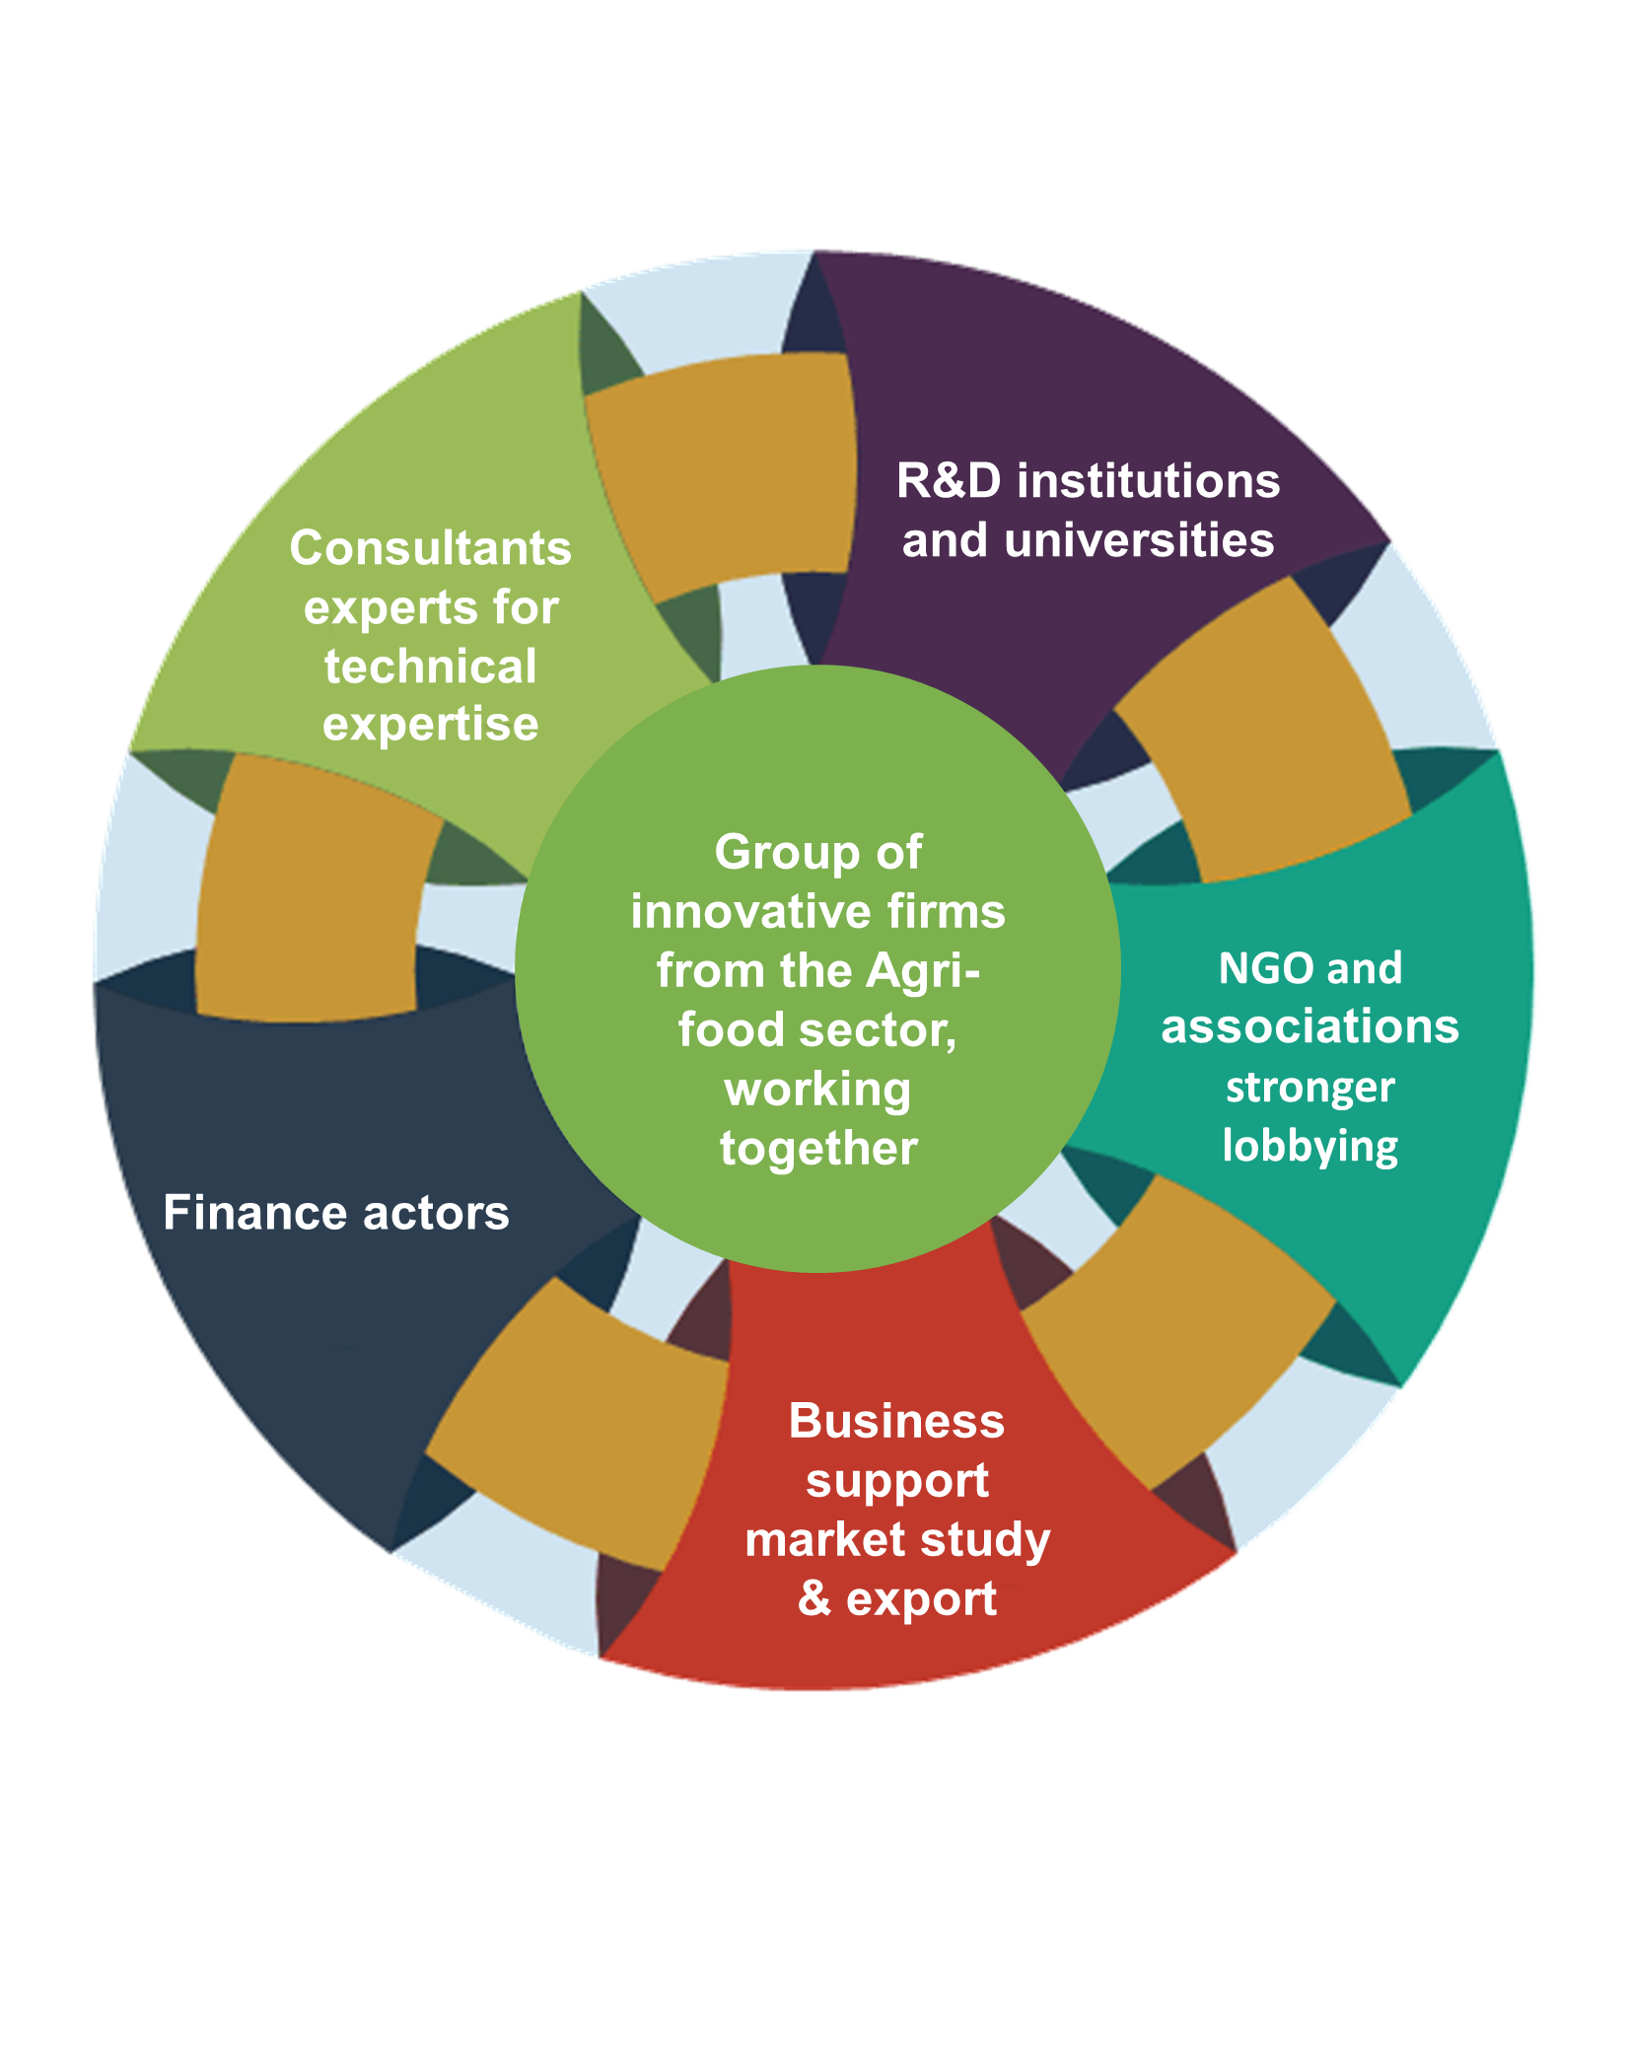
What are the consituents of a cluster
Easy access to expertise & information channels
Linkages to new markets (national and international)
Consultants experts for technical expertise
Finance actors
Public actors
Business support
market study & export

Slide 6
Cluster’s Vision
QOOT aim to be the first address for supporting innovation along the whole agrifood chain and act as a lever for LEBANON to become the center of the World Food Innovation Map
QOOT will be the first-choice-partner to cooperate with to foster the development of the Lebanese agrifood chain, and drive growth of the agriculture sector through innovation competitiveness and networking thus
Building an economy for the 21st Century:
Greener, More Innovative and More Effective Economy

Slide 7
Cluster’s Mission
QOOT work to accelerate innovation in the agri-food sector by bringing innovators, knowledge providers, investors and support institutions (innovation enablers) all under one umbrella, creating the right environment and offering the services required for Collaboration, Sustainable Growth and Internationalization of the Lebanese agri-food sector.

Slide 8
What type of Innovations
New product, variety or breed
New agricultural processing technique
Business model or concept
Technology
New packaging
Automation

Slide 9
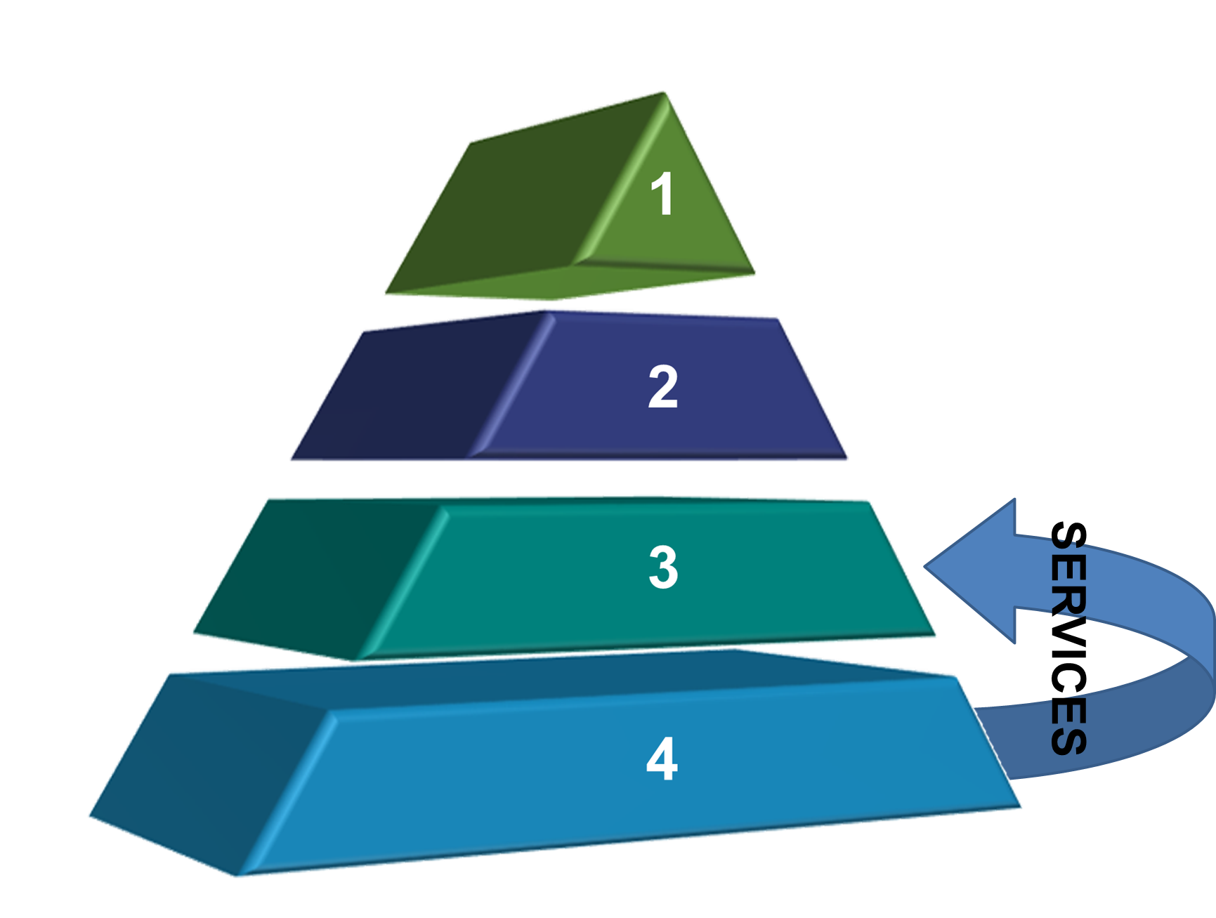
Structure & Governance
Cluster organization
Board
Steering committee, 6-8 members to ensure project output
Elected every 3 years
1
Management team
Managing project
Facilitating the activities
In charge of the implementation
2
Members
Contributing in ensuring the project output
Attending actively monthly meetings
Membership fee
Access the services
3
4
Partners
Signing MoU
Supporting in accelerating the innovations

Slide 10
Services
Business Innovation Support
Matchmaking
Internationalization
Visibility
Analyzing companies needs
Organizing Workshops and seminars
Linking companies and knowledge institutions
Organizing study trips
Bridging between partners
Assembling consortia about themes
Attracting international interest in the cluster
Supporting companies to expand internationally
Organizing joint activities with clusters abroad
Participating in national& international trade shows
Boosting and maintaining the cluster’s image
Online presence of the cluster
Registration of the companies on www.worlfoodinnovations.com
.

Slide 11
Current members are representatives from
Brasserie Almaza | Robinson Agri | Shuman Farms | Go Baladi | Chateau Kefraya | Biolicious
Smart Gourmet | Teknologix |  | Karma | The Good Thymes | Eshmoon Holistics
RV | S.M.L.C | Bioland | House of Zejd | Biomass | Colonel beer
209 Lebanese wine | Arcenciel | Unifert |  | Daher Foods | Zakka Technologies
Liban Jus | Crown Flour Mills | Gout Blanc | UNIPAK | Al Rifai | Hum’n Go

Slide 12
Why partnering with R&D institutions and Universities
Bridging between industries and universities
Raising awareness amongst industries on the R&D capabilities of universities
Emphasizing on the necessities of conducting R&D activities
Establishing innovative ideas for products with potential market opportunities at a lower R&D cost

Slide 13
QOOT and academic partnerships
Invite experts as speakers to thematic meetings of the cluster
Forward company questions to experts in the university
Publish articles/blogs of university developments that are of relevance to companies
Invite universities -if applicable- to participate in (eg EU) project proposals
Participation in cluster meetings, when fit

Slide 14
Innovation Cluster : Motives & Impact
Access to Markets
International Exposure
Human Capital Empowerment
Lobbying Power
One Voice / promotion of the sector
EU accreditation & benchmarking
International Experts Support

Slide 15
Thank You

