Slide 1
ICT Innovation Network
SRIP Smart Cities and Comunities
Andreja Lampe
Chamber of Commerce and Industry of Slovenia

Slide 2
What it is?
Smart specialization is a national platform for concentrating development investments in areas where Slovenia has the critical mass of knowledge, capacities and competences and where there is innovation potential for placing Slovenia within global markets.
9 Strategic Research & Innovation Partnerships
  The purpose of the partnerships is to coordinate development resources of the stakeholders
Smart Cities and Communities & ICT Innovation Network
  140 members
Notes:
Smart specialization is a platform for concentrating development investments in areas where Slovenia has the critical mass of knowledge, capacities and competences and where there is innovation potential for placing Slovenia within global markets.
The purpose of the partnership is to coordinate development resources of the stakeholders (companies and research organizations) in order to develop new products which will be successful on the global market.

Slide 3

Areas of focus
Digital Transformation
Location Data and Services
HPC and BigData
Internet of Services
Internet of Things
Cyber Security

Slide 4
Digital transformation
Digital platform GoOpti by GoOpti & Abelium
Transformation from local provider of low cost transfers with own vans & drivers to
regional provider of digital platform connecting passengers, drivers, shuttle owners & businesses
Notes:
Transformation from local provider of cow cost transfers with own vans & drivers to
Regional provider of digital platform connecting passengers, providers, drivers, viechele owners & businesses

Slide 5
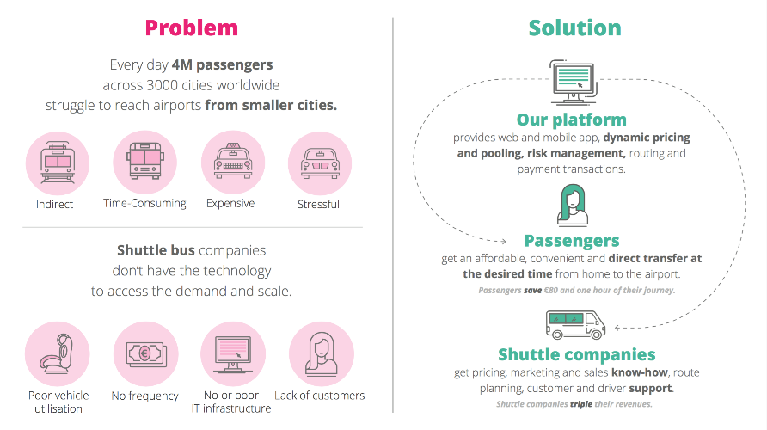
Digital platform GoOpti
by GoOpti & Abelium
Notes:
Transformation from local provider of cow cost transfers with own vans & drivers to
Regional provider of digital platform connecting passengers, providers, drivers, viechele owners & businesses

Slide 6
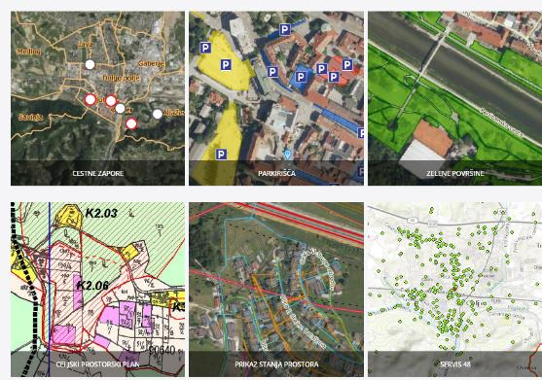
Location Data and Services
Integral Smart GIS platform by IGEA & Muncipality of Celje
Notes:
Database and archive of spatial data (PostGIS/Postgres)
Periodical spatial data replication system (Replicator)
Metadata system (GeoNetwork)
OGC and INSPIRE compliant network services WMS/WFS/WPS (GeoServer)
Web "mashup" application - mobile friendly GIS data viewer (OpenLayers)

Slide 7
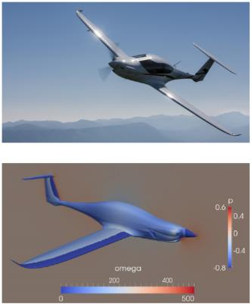
HPC and BigData
HPC-based simulation by Pipistrel, Xlab & Arctur
Options in R&D process:
wind tunnel test of a physical body
computer-based simulation of digital twin
Existing simulation cycle 20-30 days not useful for effective design process
With HPC typical cycle was reduced on 2-3 days

Slide 8
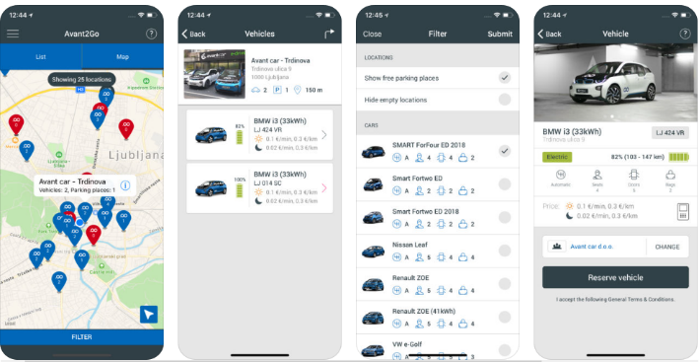
Internet of Services
Avant2Go electric car sharing platform (+ mobile app) by Avant Car & Comtrade
Notes:
Sharing mobility
Multimodal mobility
Sustainable mobility

Slide 9

Cyber Security
Encrypted communication by Biokoda

Slide 10
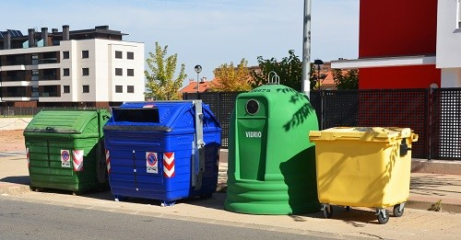
Internet of Things
Smart Waste Management
By Agitavit & Muncipality of Brežice
Notes:
Izziv naročnika
Optimizirati načrtovanje poti odvozov smeti z ekoloških otokov.
Pridobiti pregled nad polnostjo zabojnikov.
Vodenje evidenc poti in količin zbranih odpadkov so spremljali v enostavnih preglednicah.
Vodje služb za spremljanje odpadkov niso imele realnih podatkov o količini odpadkov in učinkovitosti praznjenja.
Vodstvo ni imelo ažurnih podatkov oziroma jih ni imelo s čim primerjati, da bi lahko ocenili, če delajo učinkovito.
Rešitev
Po meri razvita rešitev Smart Waste and Water Management – omrežje smetarskih zabojnikov.
Vzpostavitev informacijskega sistema za upravljanje omrežja zabojnikov na izbranih ekoloških otokih.
Razvoj algoritma, ki generira optimalne poti praznjenja zabojnikov.
Pridobivanje informacij o polnosti zabojnikov in preverjanje obstoječega sistema praznjenja.
Načrtovanje in optimiziranje poti smetarskih zabojnikov.
Prihranek pri stroških praznjenja zabojnikov.
Ažuren vpogled do informacij o višini stroškov poti in sprotno spremljanje učinkovitosti delovanja podjetja.

Slide 11

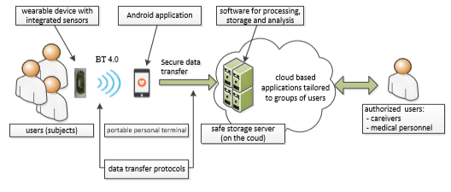
Internet of Things
SAVVY - Mobile ECG device and App -
by Josef Stefan Institute

Slide 12

Internet of Things
Autonomous Vehicle Living Lab
by BTC City Ljubljana

Slide 13
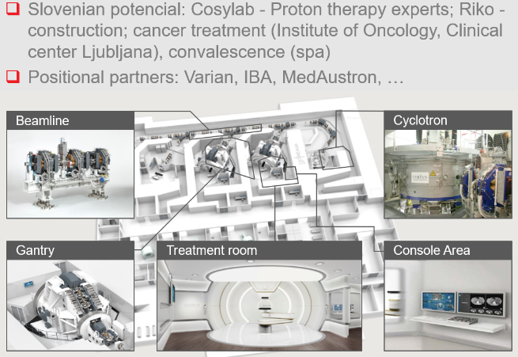
Proton Therapy Centre by Cosylab

Slide 14
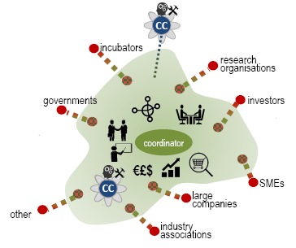
Initiative: Digital Innovation Hub Slovenia (DIHS)
Confirmed by European Commission
Digital competence development
Joint development of services to support digital transformation in companies
Promoting open innovation, designing new business models
Experimental and pilot environments
Transfer of good practices and collaboration with other DIH in the EU

Slide 15
Thank you
Andreja.lampe@gzs.si
www.ikt-horizontalnamreza.si

