Slide 1
Cluster Internationalisation EU-US Cluster Cooperation
Directorate General for Internal Market, Industry, Entrepreneurship and SMEs
Christophe Guichard
Team leader Cluster internationalisation
Unit GROW.F2 – Clusters, Social Economy & Entrepreneurship

Slide 3
Cluster Internationalisation Programme for SMEs (COSME, €19M)
Supporting SME access to global value chains through clusters
European Cluster Collaboration Platform
The hub connecting clusters across Europe and beyond.
Over 690 cluster organisations profiled !!!
International cluster matchmaking events in third countries and Europe
6 Events in 2016 with: US, Taiwan, Iran, Mexico, Brazil & EU Cluster conference
5 events in 2017: US, Taiwan, Paris Air Show, Thailand, Greece
European Strategic Cluster Partnerships – Going International (ESCP-4i)
"Clusters Go International" action promoting SME internaliationalistion towards 3rd countries
15 EU Cluster partnerships implementing joint strategies to go international

Slide 4
The European Cluster Collaboration Platform -ECCP The Platform Connecting Cluster Organisations
ECCP is a service facility aiming to provide cluster organisations modern tools for the benefit of their SMEs to:
map and profile cluster organisations across Europe (and beyond) - currently over 690 organisations (incl. 40 non-European organisations)
support networking and search for potential partners
access the latest information on cluster events and development in Europe and third countries
develop collaboration trans-nationally (within Europe) and internationally (beyond Europe) through matchmaking events
Promote EU Cluster partnerships implementing joint internationalisation strategies (ESCP-4i)

Slide 6
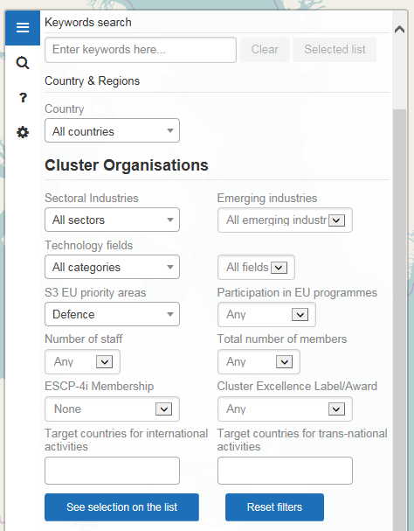
The European Cluster Collaboration Platform -ECCP The Platform Connecting Cluster Organisations

Slide 7
International Cluster Match-making Events (1)

Slide 8
International Cluster Match-making Events (2)
2016
EU-USA Event, Hannover Messe, 25-26 April 2016
Focus: Advanced manufacturing, industrial automation, environmental technology, etc.
Participation of over 75 EU and US clusters /EDOs with 250 one-to-one meetings, 121 cooperation cases
Taiwan -EU Event, ICT Fair Computex, Taipei, 30 May-3 June 2016
Participation of 23 EU clusters - 120 one-to-one meetings with Taiwanese organisations
Iran – EU event, EU Economic Mission led by Commissioner Bienkowska, 17-19 Oct. 2016
Focus: automotive and mobility, tourims and sports, textile, biotech and green tech
Participation of 14 EU clusters and 60 Iran organisations – 7 industrial site visits
Mexico – EU event, Green Expo, 25-27 October 2016
Focus: Renewable energy, Energy efficiency, Waste management, Wastewater management
Participation of 38 EU clusters and Mexican organisations - in cooperation with the Low Carbon Business Action (funded under FPI, EEAS)
EU – Brazil Event, Pollutec, Lyon, 28-30 November 2016
Participation of 35 EU clusters and Brazil organisations – Green technologies
EU Cluster Event, Brussels, 30 November 2016 - prior to the European Cluster Conference 2016
Participation of 115 EU clusters across 21 European countries – 500 one-to-one meetings

Slide 9
International Cluster Match-making Events (3)
2017
EU Cluster Mission to the USA, 15-19 May 2017
US-EU Cluster Matchmaking Event, TechConnect World Innovation Conference, Washington D.C., 16-17 May 2017
Cluster visits to Boston, Philadelphia and Washington D.C.
Focus: Nanotech, Advanced manufacturing and processing, Advanced materials, Biotech, Energy and sustainability, Electronics and microsystems, etc.
Participation of 19 EU clusters – 118 one-to-one meetings, 25 cooperation cases initiated
EU – Taiwan Cluster Matchmaking Event, Brussels, 26-27 June 2017 – Participation of 25 European clusters – Focus: Smart industry, Circular economy and 5G
Paris Air Show, European Cluster matchmaking Event, 22 June 2017 - Participation of 25 European clusters promoting cross-sectoral cooperation in the aerospace sector
EU – Thailand Cluster Matchmaking Event, Bangkok, 5-8 September 2017 – Healthcare and medical technologies – in cooperation with the EU Gateways and Business Avenues programme of FPI, EEAS

Slide 10
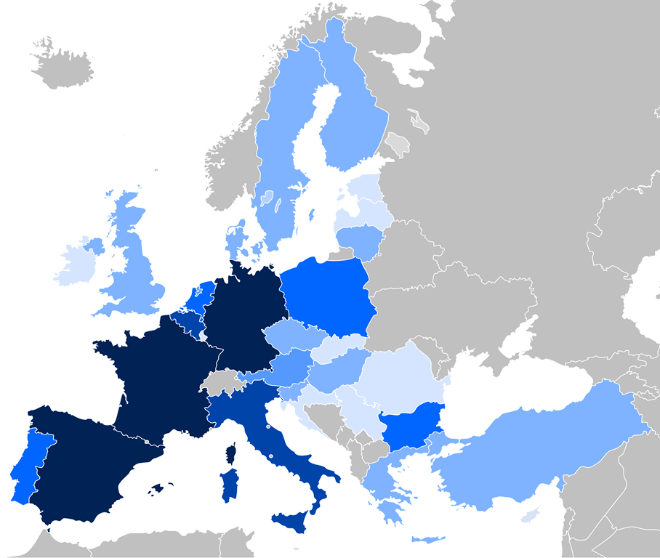
'Clusters Go International' action
Promoting cluster cooperation for industrial leadership in global markets
through
European Strategic Cluster Partnerships for Going International (ESCP-4i)
2 "Cluster Go International" calls for proposals (2014/2015 and 2016)
15 projects (4.30 mio €) plus 17 expected new projects (5.79 mio €)
98 cluster organisations (15 projects) representing over 10,000 SMEs
Supporting joint international strategies and collaboration with partners in third countries for the benefit of SMEs
Nb of partners involved per country in this action
0
1-3
4-6
7-9
10+

Slide 11
'Clusters Go International' action
Overall, 15 EU Cluster Partnerships "Go international" (+ 10 non-funded)
involving: 98 European cluster organisations
10,000 SMEs across 23 European countries
6 clusters and 700 SMEs in each partnership in average
Others: Chile, Peru, South Korea, Taiwan, ASEAN, North Africa, Gulf/Middle East, India, Australia

Slide 12
List of European Strategic Cluster Partnerships – Going International (ESCP-4i)
http://www.clustercollaboration.eu/escp-list

Slide 13
Clusters are being recognised on both sides of the Atlantic as boosters of the economy. A Cooperation Arrangement on Clusters was signed between DG GROW and the US Department of Commerce in April 2015 see at: https://www.clustercollaboration.eu/news/eu-us-cooperation-arrangement-clusters-signed-washington-dc-1 The objective is to facilitate transatlantic linkages between EU and US clusters, and help SMEs find strategic partners.
EU – US Cluster Cooperation Arrangement

Slide 14
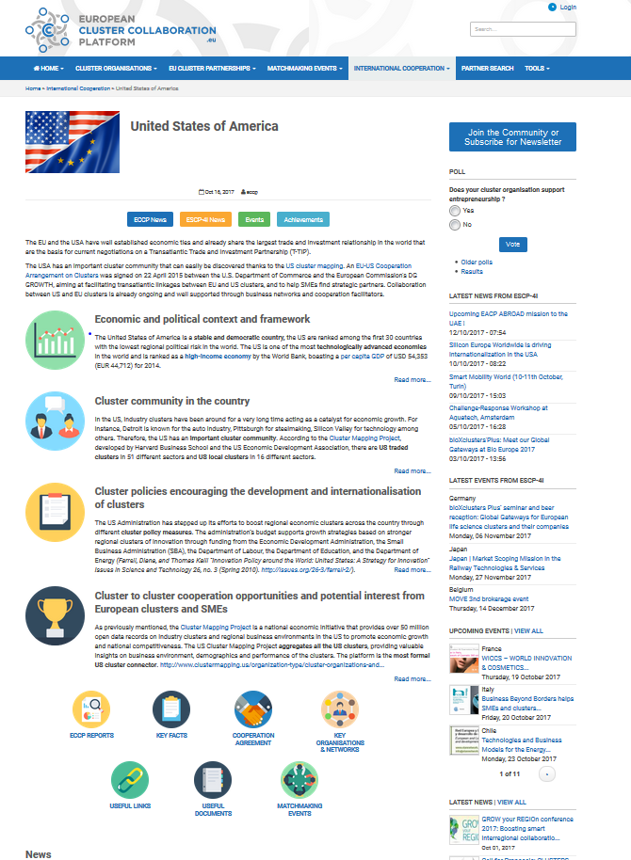
ECCP page on USA cluster landscape

Slide 15
EU – US Cluster Cooperation Activities (1)
Past activities (2015-2016)
Cluster & Business Matchmaking event, at Milan Expo 2015 EU-US Days, Italy, October 2015 – 19 EU clusters in agro-food and resource efficiency
EU-US Workshop on best practices in cluster mapping and cluster-based economic policies in Boston (at Harvard Business School) and Washington, D.C. in November 2015 - 77 cluster policy-makers, experts and researchers from EU and the US.
EU-US Cluster Matchmaking Event at Hannover Messe, April 2016, by DG GROW and the U.S. Department of Commerce:
Over 70 EU and US clusters and Economic Development Organisations
140 meetings between EU-US organisations
7 concrete cooperation plans initiated
High Level Policy Seminar introduced by EU Commissioner Bienkowska, US Deputy Secretary of Commerce and State Secretary of Germany Federal Ministry for Economic Affairs

Slide 16
EU – US Cluster Cooperation Activities (2)
2017 activities
High level EU Cluster Mission to the USA, 15-19 May 2017
Under the initiative of DG GROW and the U.S. Department of Commerce, facilitated by the European Cluster Collaboration Platform (funded under COSME) and the Bilat 4.0 initiative (funded under H2020)
US-EU Cluster Cooperation Seminar and Matchmaking Event, TechConnect World Innovation Conference, Washington D.C., 16-17 May 2017
Cluster visits to Philadelphia and Boston area
Participation of 19 EU cluster organisations from 10 EU MS
Focus: Nanotech, Advanced manufacturing and processing, Advanced materials, Biotech, Energy and sustainability, Electronics and microsystems, etc.
Planned activities
High level EU-US Cluster Cooperation and Matchmaking event, in Europe (place and date, tbc)

Slide 17
Priority Target Markets by European clusters
87% of European clusters interested to support internationalisation of their SMEs in third markets

Slide 18
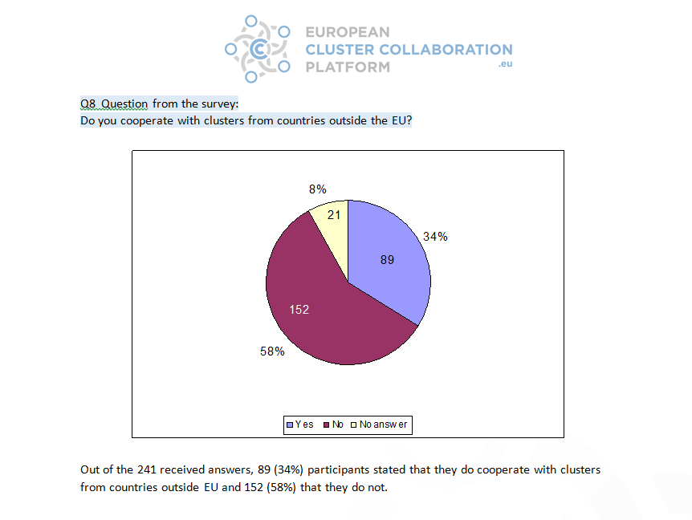
Only 1/3 European clusters initiate cooperation with third markets

Slide 19
More information
EU Cluster Portal:
http://ec.europa.eu/growth/smes/cluster/
European Cluster Collaboration Platform (ECCP)
http://www.clustercollaboration.eu/
ECCP US page:
https://www.clustercollaboration.eu/international-cooperation/united-states-america
European Strategic Cluster Partnerships – Going International
http://www.clustercollaboration.eu/eu-cluster-partnerships
Twitter: @Clusters_EU
Thank you for your attention

