Slide 1
InvestEU programme 2021-2027
Georg Raab, European Commission (DG GROW)
SME Access to Finance

Slide 2
InvestEU Programme: an overview
InvestEU Fund:
EUR 26.2 bn EU budgetary guarantee
Objective to mobilise EUR 370 billion euro in additional investment, of which 30% to contribute to climate objectives
Projects to be financed under 4 policy windows
€ 6.9 bn
€ 9.9 bn
€ 2.8 bn
€ 6.6 bn

Slide 3
Main principles of the EU Guarantee
Single programme: a single Regulation and agreement with each implementing and advisory partner
Direct access to the EU guarantee open to multiple implementing partners (75% for EIB Group)
Budgetary guarantee: no funded instruments
Member State compartment and link to Recovery and Resilience Facility: Good possibility to boost support at regional level through geographically ring-fenced financial products
Blending: harmonised combination rules

Slide 4
SME window of InvestEU: Debt Products
Innovative & innovation-driven
Cultural and Creative Sector
Transformative digitalisation
Sustainability activities (need to pilot)
Single European Guarantee Facility addressing multiple policy objectives
Portfolios of newly generated higher risk SME financing transactions (e.g. for start-ups, SMEs with insufficient collateral)

Slide 5
Set up of the guarantee facility
Financial intermediaries are free to choose which area they would like to address
General competitiveness guarantee for:
Start–ups
Transactions with reduced collateral requirements, longer maturities
Generally riskier products (e.g. subordinated lending)
Possibility to do volume deals (significantly extending financing volumes beyond standard volumes)
Always has to be complementary to the existing business practices of the financial intermediary
Disclaimer: The exact content of the intervention is under negotiation
with the European Investment Fund

Slide 6
SME window: sustainability criteria
Investments and working capital
Green enterprise
 |  | Financing supported as the final beneficiary qualifies as green, i.e. green revenues, business model, acknowledgement through prizes, intellectual property, labels etc. Financing supported to any eligible SME that will use the loan for “green” investments as per the 6 taxonomy objectives: Climate changes mitigation (e.g. energy efficiency, green mobility, green ICT) Climate change adaptation (e.g. improved resilience to climate change) Circular economy (waste management, ICT solutions enabling circularity) Pollution prevention (e.g. reducing pollutant emissions into air, noise) Water (e.g. investment in water saving technologies) Biodiversity (e.g. protection and restoration of biodiversity and ecosystems) Agriculture and forestry
Green investments

Slide 7
SME window of InvestEU: Equity products
Gender Smart Investments
IPOs
Strategic Digital investments / cultural and creative sector
Climate & Environmental Solutions
Enabling sectors & technologies
Capital Markets Union
Disclaimer: The exact content of the intervention is under negotiation
with the European Investment Fund

Slide 8
General scheme
Implementing Partners (IPs)
Beneficiaries
Programmes
Direct loans
SMEs and small mid-caps across the EU
Financial intermediaries:
Banks, guarantee societies, microfinance providers, venture capital, equity funds, etc.
InvestEU Guarantee
MS compartment
Financing (loans, guarantees and venture capital/ equity investments)
Other IPs (IFI, NPB)
Max 5% transfer
Shared management funds
(Managing Authorities)
FIs under shared management
IP chosen by MS
According to relevant OP
IFI: International Financial Institution (e.g. EBRD); NPB: National Promotional Banks

Slide 9
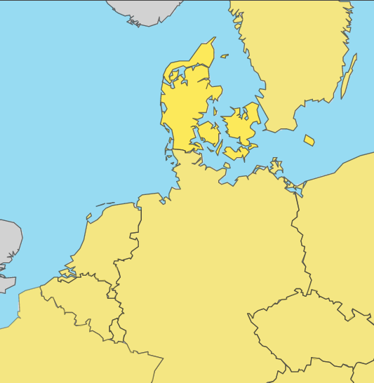
How to apply for EU finance
www.access2finance.eu

Slide 10
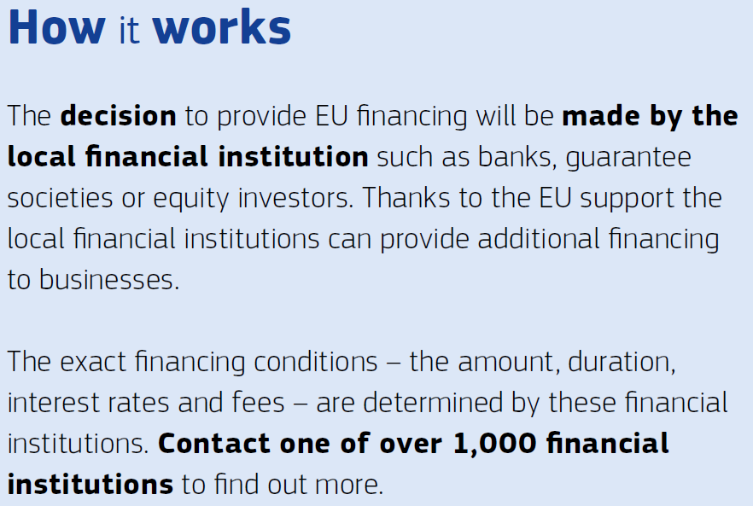
Digital roadshow throughout 2022

