Slide 1
European agricultural fund for rural development (EAFRD) - opportunities for SMEs
Directorate General for Agriculture and Rural Development
Gregorio Dávila Díaz – Unit F1

Slide 2
Agri-food sector in the EU
Agricultural industry created gross value added of EUR 177.0 billion in 2020
Almost
40
million jobs in the agri food sector
450 million consumers
10.2 million farms
20
million people employed in agriculture
Notes:
The agricultural industry created an estimated added value of EUR 177.0 billion in 2020
The gross value added by the EU’s agricultural industry, which is the difference between the value of everything that the EU’s primary agricultural sector produced and the costs of the services and goods used in the production process, was an estimated EUR 177.0 billion in 2020. One way of looking at this is that for every 1 euro spent on the cost of goods and services used in the production process (known as intermediate consumption), the EU’s agricultural industry created added value of EUR 0.75. Whilst this relative value added was lower than the EUR 0.76 in 2019 and the EUR 0.79 in 2017, it was still higher than all the other years since 2007.
Agriculture contributed 1.3 % to the EU-27’s GDP in 2020. Agricultural production in the EU by the millions of predominantly small farms adds up to being big business, even without considering its importance as the key building block for the downstream food and beverage processing industry. The agricultural sector contributed EUR 171.9 billion towards the EU’s overall GDP in 2020. To put this in some context, the contribution of agriculture to the EU’s economy was only slightly less than the GDP of Greece, the 16th largest economy among the EU Member States.

Slide 3
CAP Objectives & sustainability dimensions
ECONOMIC
ENVIRONMENTAL
SOCIAL

Slide 4
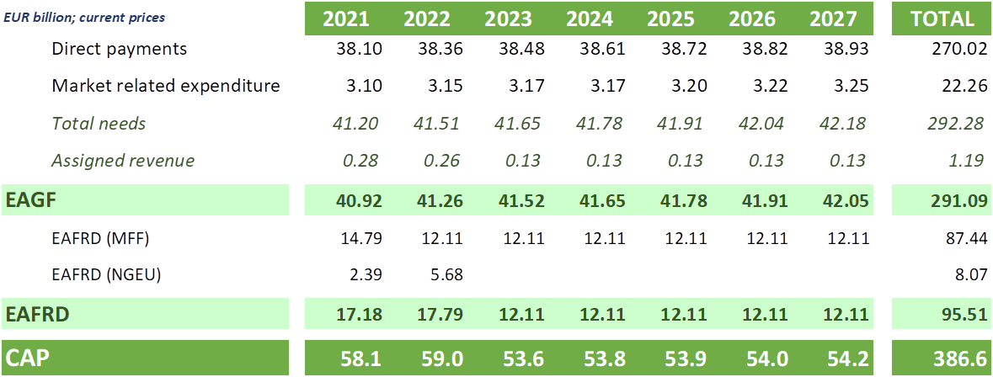
CAP budget

Slide 5
Rural development support instruments
Investments (examples):
Physical assets (agriculture, forestry)
Business start-up
Infrastructures
Non-productive investments
Restoration/prevention natural disasters (agriculture, forestry)
Land management & animal related payments (examples):
Environmental commitments (agriculture, forestry)
Organic Farming
Animal welfare
Areas with natural constraints
Areas subject to specific management requirements
SMEs are eligible
SMEs are eligible
Training/technology (examples):
Knowledge transfer
Advisory services
Cooperation
European Innovation Partnership for agricultural productivity & sustainability
Other schemes (examples):
Technical Assistance
Participation in quality schemes
Setting-up of producer groups
Risk management toolkit
Local Development Strategies

Slide 6
CAP Strategic Plans – shared management
Single CAP plan for all interventions with a common monitoring system
Strategic approach based on needs assessment
Structured dialogue with Member States
MS draws up and submits the CAP Plan
CAP Plan will be approved by the Commission

Slide 7
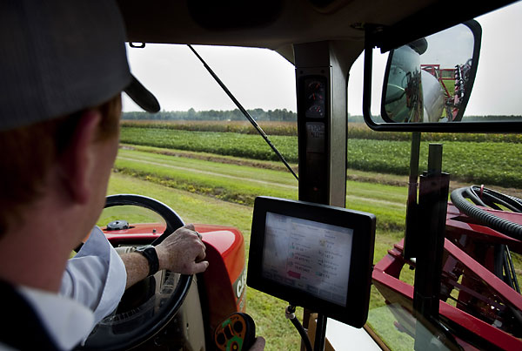
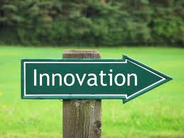
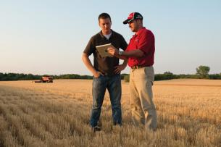
Some targets from 2014-2020 period…
3,6 million training places
13 036 co-operation projects
341 500 investments in restructuring or modernisation
174 500 business development plan/investments for young farmers
208 000 agricultural holdings participating in quality schemes, local markets and short supply circuits, and producer groups/ organisations
594 000 agricultural holdings participating in risk management schemes

Slide 8
Thank you
© European Union 2020
Unless otherwise noted the reuse of this presentation is authorised under the CC BY 4.0 license. For any use or reproduction of elements that are not owned by the EU, permission may need to be sought directly from the respective right holders.
Slide xx: element concerned, source: e.g. Fotolia.com; Slide xx: element concerned, source: e.g. iStock.com

