Slide 1
Fostering Collaboration Between the Enterprise Europe Network (EEN) and the Marie Sklodowska- Curie Actions and National Contact Points Network (MSCA-NET)
24th June 2022
Jesús ROJO
EEN-MADRID Coordinator
MSCA National Contact Point
Notes:
Introduction: explain that what we do – in a nutshell – is to help ambitious SMEs innovate and grow internationally.

Slide 2
Agenda
The MSCA-NET Project
MSCA opportunities for EEN clients
Fostering collaboration between EEN and MSCA
SMEs Participation in MSCA during Horizon 2020
The MSCA Matchmaking Platform

Slide 3
The new Marie Skłodowska-Curie NCP Project
Name: MSCA-NET
Start: 1 March 2022
Duration: 36 Months
Budget: €1.87 Million
Objectives:
Improve, professionalise & harmonise services of MSCA NCPs
Simplify access of potential applicants to the HE MSCA Calls
https://msca-net.eu/
COORDINATOR: Euresearch (CH)

Slide 4
5 Work Packages
WP1
Management & Communication Lead: CH
Lead: CH Beneficiaries: All
WP2
Training, Mentoring & Support Lead: IT
Lead: EL (CERTH) Beneficiaries: CH
WP3
Tools Lead: IL
Lead: CH Beneficiaries: all
WP4
Strategic Capacity Development Lead: HU
Lead: CH Beneficiaries: BG, EL (CERTH), ES (FECYT), EE
WP5
Synergies & Collaborations
Lead: ES
Lead: CH Beneficiaries: BG, EL (CERTH), ES (FECYT), EE

Slide 5
WP5 - Synergies & Collaborations
Task 5.3 Non-academic sector in MSCA. Collaboration with the Enterprise Europe Network
Improvement SMEs Participation in MSCA Calls
Increase the collaboration EEN-MSCA NCPs
Transfer of Knowledge EEN advisors – MSCA NCPs
Joint Events / Signposting Clients
Training Sessions from EEN Advisors to MSCA NCPs
MSCA Matchmaking Platform
Increase the number of Achievements in the EEN

Slide 6
MSCA opportunities for EEN Clients
HORIZON EUROPE
EURATOM
Specific Programme: European Defence Fund
Specific Programme implementing Horizon Europe & EIT*
Exclusive focus on civil applications
Fusion
Pillar I
Excellent Science
Pillar II
Global Challenges & European Industrial Competitiveness
Pillar III
Innovative Europe
Exclusive focus on defence research & development
European Research Council
Health
Culture, Creativity & Inclusive Society
Civil Security for Society
Digital, Industry & Space
Climate, Energy & Mobility
Food, Bioeconomy, Natural Resources, Agriculture & Environment
European Innovation Council
Fission
Research actions
Marie Skłodowska-Curie
Clusters
European Innovation Ecosystems
Research Infrastructures
European Institute of Innovation & Technology*
Development actions
Joint Research Centre
Joint Research Center
Widening Participation and Strengthening the European Research Area
Widening participation & spreading excellence
Reforming & Enhancing the European R&I system
* The European Institute of Innovation & Technology (EIT) is not part of the Specific Programme

Slide 7
Pillar I: Excellent Science
Reinforcing and extending the excellence of the Union's science base
European Research Council
Frontier research by the best researchers and their teams
Marie Skłodowska Curie Actions
Equipping researchers with new knowledge and skills through mobility and training
Research Infrastructures
Integrated and inter-connected world-class research infrastructures
€16 billion
€6.6 billion
€2.4 billion
Notes:
Marie Sklodowska Curie Actions, which is the European Union’s flagship programme to support scientific excellence and cooperation across countries, sectors and research fields, equipping researchers and its organisations, with new knowledge and skills through mobility and training.
As you know, in a world in which research is carried out on a global basis, international interaction is important to scientific success.
Total budget for MSCA Horizon Europe time spam is 6.6 billion.

Slide 8
MSCA: Key policies
Researchers’ training, skills & career development
(all career stages)
Attractive working & employment conditions
Structuring impact on organisations through excellent programmes
Excellent research in all domains (bottom-up approach)
International,
cross-sectoral & interdisciplinary mobility
Strong collaboration with industry & SMEs
Notes:
Among the aims of the ensemble of the MSCA, it is the support to researchers in their quest to improve and develop their careers via training schemes, and mobility programmes were they can acquire new skills (at all career stages, both for early researchers and experience researchers).
This will contribute to improve their working and employment conditions.
In the core of MSCA objectives is to support excellent research in all domains, with a bottom-up approach. Many of the projects (at least in the past Research and Innovation Staff Exchange) where designed by the researchers than then will participate in the exchanges.
This bottom up approach help to structure the impact on organisations through the participation in excellent research and exchange of knowledge and skills.
Also very important to consider the international, cross-sectoral and interdisciplinarity mobility of researchers. As you know, researcher’s mobility contributes to the circulation of skills and ideas around the world. Mobility allows researchers to share specialist expertise, skills or equipment and expand their collaboration networks in different countries, sectors and disciplines. Not only does help scientists to develop their experience but also internationally mobile researchers produce more papers on average than those who have only ever worked in their native country.
Participating organisations in MSCA, both academic and non academic (industry and SMEs) confirmed that they have increase and reinforced their networks and established long-lasting collaborations that goes beyond the duration of the projects.

Slide 9
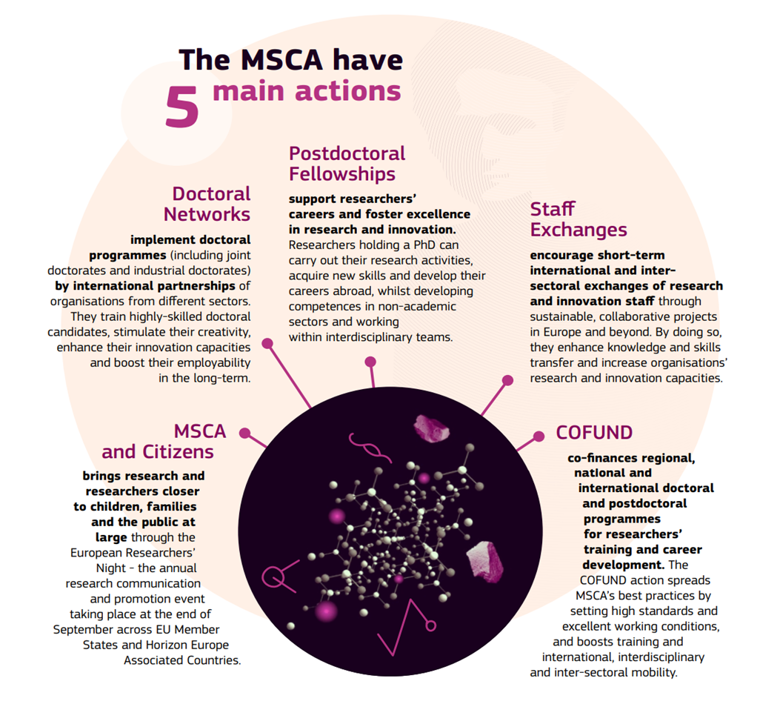
MSCA opportunities for EEN Clients
Compulsory SME Participation
Doctoral Networks (Consortium)
Staff Exchanges (Consortium)
COFUND (Consortium)
Highly Recommended
Postdoctoral Fellowships (Monobenef)
SMEs can participate as beneficiaries
or
Associated Partners by Secondments and Placements

Slide 10
MSCA opportunities for EEN Clients
Doctoral Networks
Training of new researchers generation
Non-Academic Sector Exposure
Special modality: Industrial Doctorate
Benefits for EEN Clients
100% Funding Rate
Talent Attraction
International Cooperation
15-18% Success Rates
No topics!
Benefits for EEN members
PAs Research

Slide 11
MSCA opportunities for EEN Clients
Staff Exchanges
Research and Innovation Project in international consortiums
Staff Exchanges between Academia y Non-Academic Sector
Benefits for EEN Clients
Receiving experts during period of time for project activities
International Cooperation – The most international h2020 programme. 145 countries involved.
Successful Project Results – New Services / Products
25% Success Rates
No topics!
Benefits for EEN members
PAs Research

Slide 12
MSCA opportunities for EEN Clients
COFUND
Co-funding programmes for recruitment predoctoral and postdoctoral researchers
Benefits for EEN Clients
Host predoctoral and postdoctoral researchers
International Cooperation
Talent Attraction.
30% Success Rates
100% funding
No topics!
Companies participates as associated partners.
Benefits for EEN members
PAs Research and AAs

Slide 13
MSCA opportunities for EEN Clients
Postdoctoral Fellowships
Career Development for researchers
24 months projects in Europe – 36 months in Third Countries and compulsory return to Europe
Benefits for EEN Clients
Talent Attraction
100% funding rate
14% Success Rates – High Competition
No topics!
Secondment and Placements in Companies
Benefits for EEN members
AAs

Slide 14
MSCA opportunities for EEN Clients
Secondments
Researchers receiving a Postdoctoral Fellowship may opt to include a secondment phase, within the overall duration of their fellowship in any country worldwide.
Placements
An additional period of up to six months to support researchers seeking a placement at the end of the project to work on R&I projects in an organisation from the non-academic sector
This incentive aims at promoting career moves between sectors and organisations and thereby stimulate innovation and knowledge transfer while expanding career opportunities for researchers.

Slide 15
MSCA Calls Calendar
Postdoctoral Fellowships 2022
12th May
14th Sept
Doctoral Networks 2022
12th May
15th Nov
Staff Exchanges 2022
6th Oct
8th March
COFUND 2022
11th Oct
9th Feb
2022
2023

Slide 16
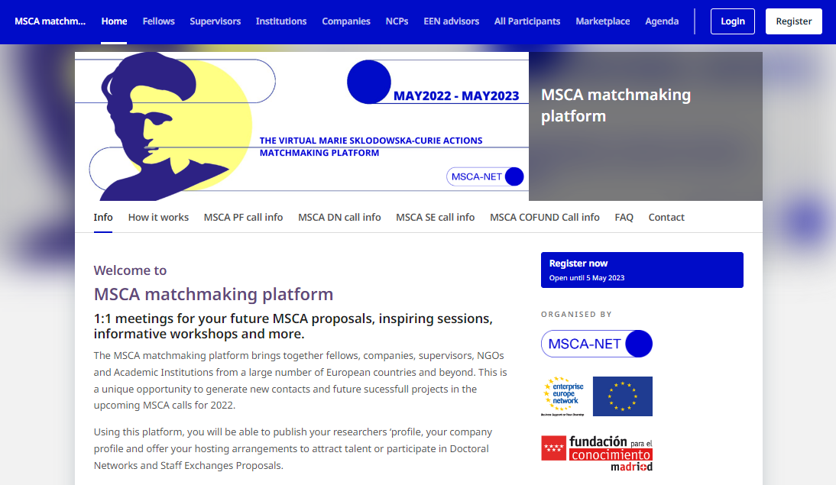
The MSCA Matchmaking Platform
Virtual Space for partnering in MSCA Calls
Open during 12 months (may22-may23) possible extension to 24 or 36 months.
Covering 4 MSCA calls
8 types of participants
806 participants and growing
180 opportunities in the Marketplace
https://msca.b2match.io/

Slide 17
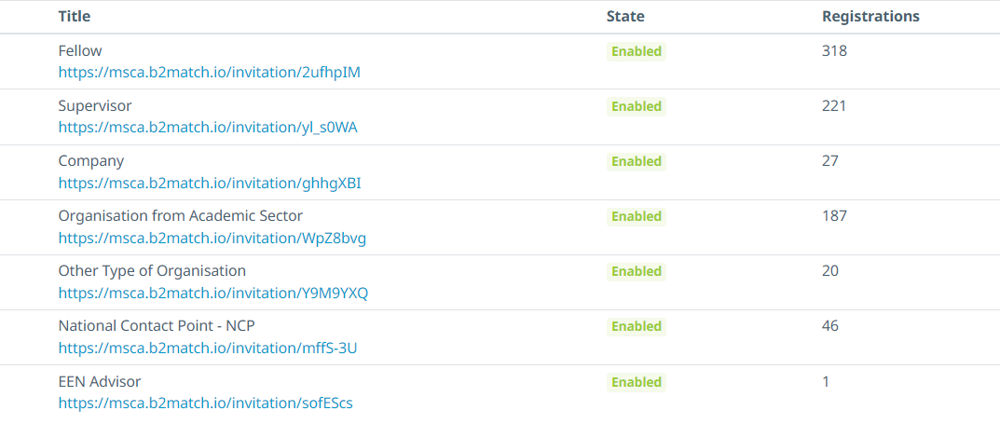
The MSCA Matchmaking Platform
Participants
Future Fellows
Supervisors
Companies
Academic Institutions
Other Organizations
NCPs
EEN Advisors
https://msca.b2match.io/

Slide 18
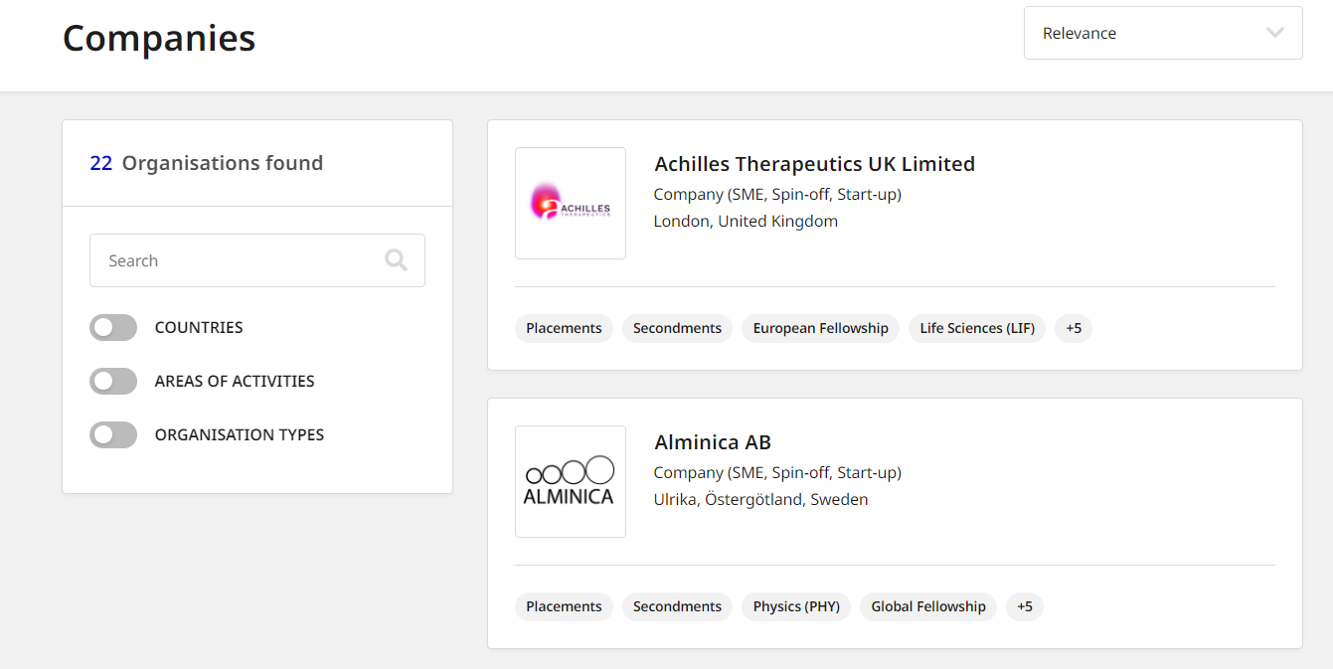
The MSCA Matchmaking Platform
Companies participation
22 companies registered
2 Corporations
4 NGOs
https://msca.b2match.io/

Slide 19
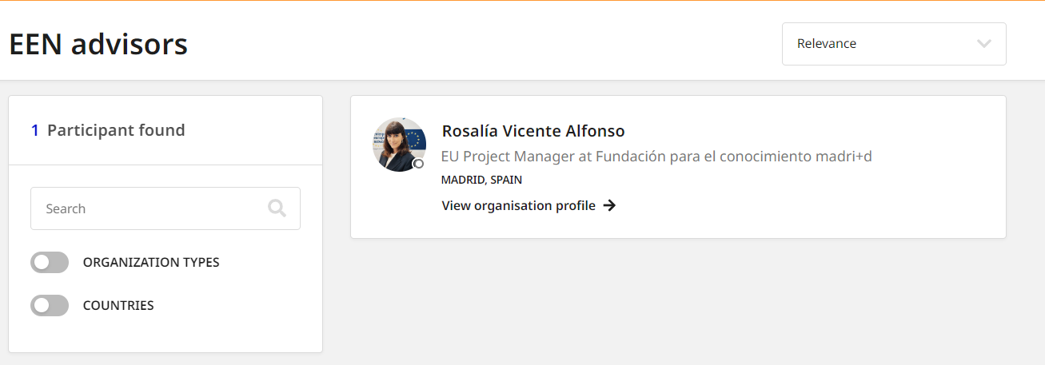
The MSCA Matchmaking Platform
EEN Advisors
1 member registered
Assist Participants
Check for opportunities
EEN advisor will allow to book meetings with NCPs from your country and applicants.
https://msca.b2match.io/

Slide 20
SMEs in MSCA during horizon 2020
Individual Fellowships
463 private companies // 166 SMEs
Innovative Training Networks
7,252 private companies
1,309 companies (SMES)
RISE (Staff Exchanges)
2,250 private companies
954 Companies (SMEs)
COFUND
361 private companies
65 Companies (SMEs)
Private Sector (PRC): 4,885 entities
Of which:
SMES, Spin-offs and Start-ups: 2,221
NGOs, associations, foundations: 481
of which NGOs: 385
Notes:
Doctoral networks (focused on early researchers) – which target doctoral programmes supporting research in academia and other sectors
Postdoctoral Fellowship (experience researchers) – supporting the careers of individual researchers and promoting excellence.
Staff Exchanges: promoting knowledge collaboration between organisations and sharing practices in the context of a research project by researchers mobility
COFUND: supports regional, national and international doctoral and postdoctoral programmes through co-funding.

Slide 21
Next Steps
Register as EEN advisor in the MSCA-NET Matchmaking Platform
Contact your NCP, Meet your MSCA NCP
Promote MSCA opportunities among your clients
Collaborate with your MSCA NCP. Most of the NCPs and MSCA applicants need EEN Support on many topics:
Impact, Commercialization, IP Strategy, Innovation…

Slide 22
Make it happen

Slide 23
Thank you
Follow us at
https://msca-net.eu/
@MSCANetwork
MSCA-NET
@MSCANET

