Slide 1
Welcome to the European Cluster Collaboration Platform!
Twitter: @Clusters_EU
Marc Pattinson
ECCP Project coordinator
EU-Korea Cluster Matchmaking Event
EU Utility Week,Vienna, Austria
7-8 November, 2018

Slide 2
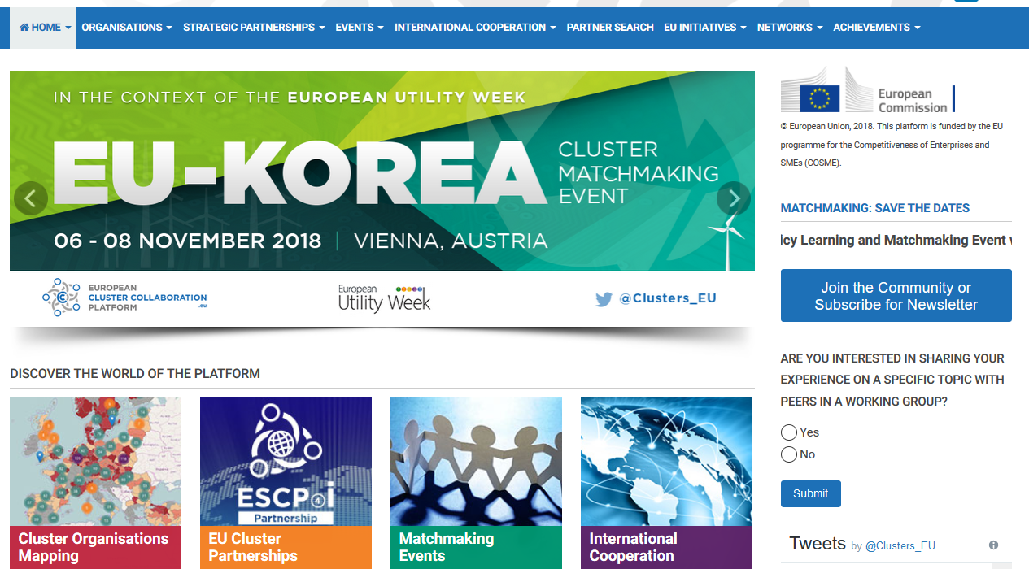
What is the European Cluster Collaboration Platform?
www.clustercollaboration.eu
Your hub for cluster collaboration in Europe and beyond – for the profit of your members!
Profile your cluster / business organisation
Engage with partners & find information
Make use of our diverse tools…

Slide 4
ECCP selected key achievements over past 3 years :
11.500 monthly visitors on the website
115 weekly digests/newsletters
3250 user accounts created
1950 news published (61% by users)
945 events promoted (51% by users)
163 calls published
57 partner searches published
47 cluster associations/networks featured
50 profiled ESCP-4i partnerships
58 cluster projects profiled (including INNOSUP and Cluster Excellence)
4 webinars
6 user surveys
280 references to the ECCP in external media

Slide 5
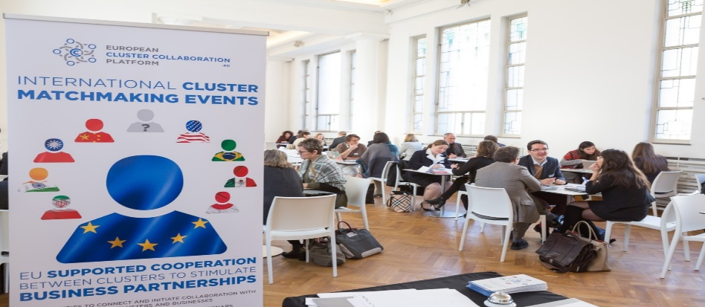
Cluster Matchmaking Events (co-) organised by the ECCP (funding available for clusters)
During 2016-2017 ECCP there were 10 matchmaking events
USA (April 2016), Iran (October 2016), Mexico (October 2016), Europe/Brussels (November 2016), Brazil (November 2016), USA (May 2017), Europe/Aerospace/Paris (June 2017), Taiwan (June 2017), Thailand (September 2017), Europe/Thessaloniki (September 2017)
For the period 2017 – 2019 there are 8 cluster matchmaking events planned
Europe/Brussels (February 2018), Ukraine (March 2018), Taiwan (June 2018), Western Balkans in Zagreb (22-23 November 2018), EU-Korea within the Utility Week in Vienna (6-8 November 2018), Canada (Spring 2019) and… stay tuned!
During these events (Over 3 years not including EU-Korea):
2984 bilateral meetings were held
439 European cluster organisations participated
159 participants from countries beyond Europe attended
363 cooperation cases were developed
27 formal agreements signed
28 European countries were represented
7 non-European countries represented (iUSA, Taiwan, Brazil, Mexico, Iran, Thailand and Korea)
9 international cooperation events were organised

Slide 6
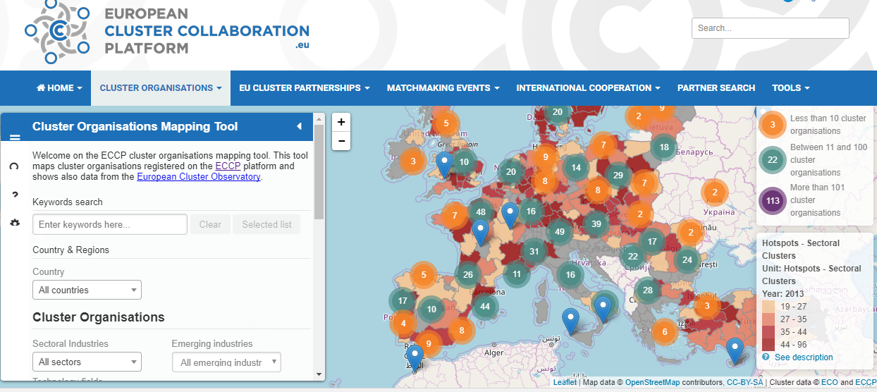
Cluster Organisations Mapping
Set up a profile on ECCP and put your cluster on the map!
Search by multiple criteria: sector, technology fields, country…
Currently 880 clusters mapped (out of which 68 beyond Europe).
51 clusters are targeting Korea for their international activities

Slide 7
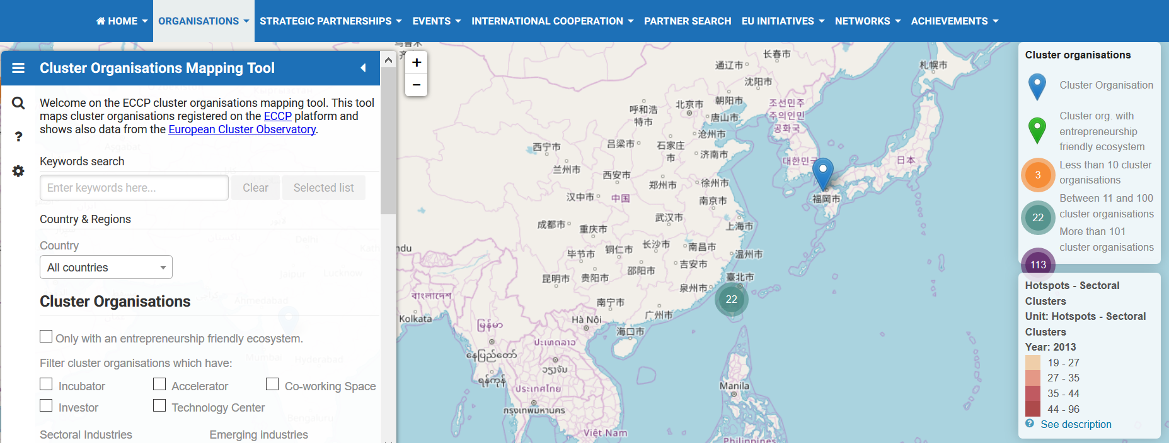
Korean cluster organisations are welcome. Create your profile now !!

Slide 8
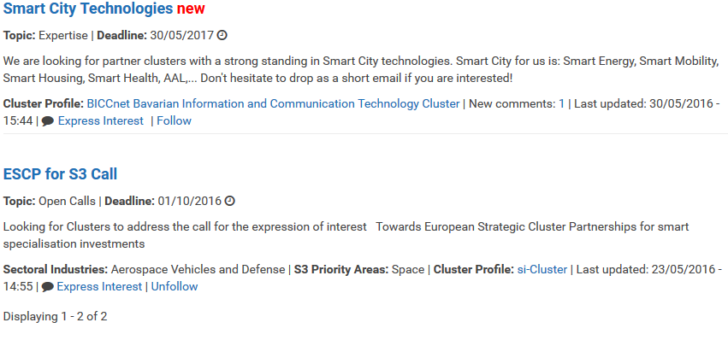
ECCP – The Networking Hub (Partner search)
Bookmark favourite profiles
Search for keywords
Notification of relevant profiles
Filter by sector
Reference to open calls
Filter by country
Expression of interest
Activity summary
Short summary

Slide 9
ECCP Tools – European Cluster Initiatives

Slide 10
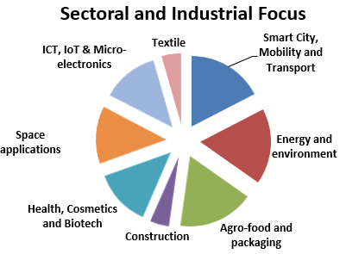
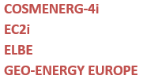
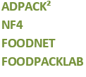
ECCP – Cluster Go International : Overview 2018

Slide 11
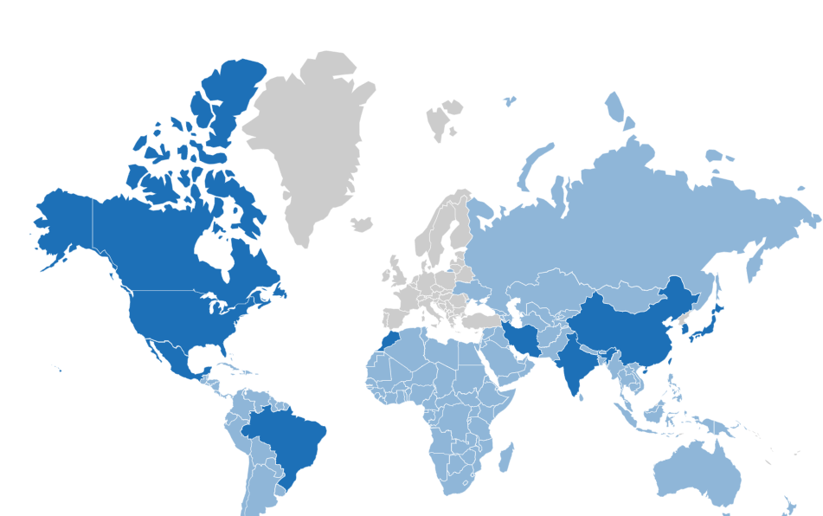
ECCP – International Cooperation
Support for existing and launching of new dynamic MoUs between the European Commission and third country strategic partners (briefing documents, strategic meetings, country reports on respective cluster landscapes, etc.)

Slide 12
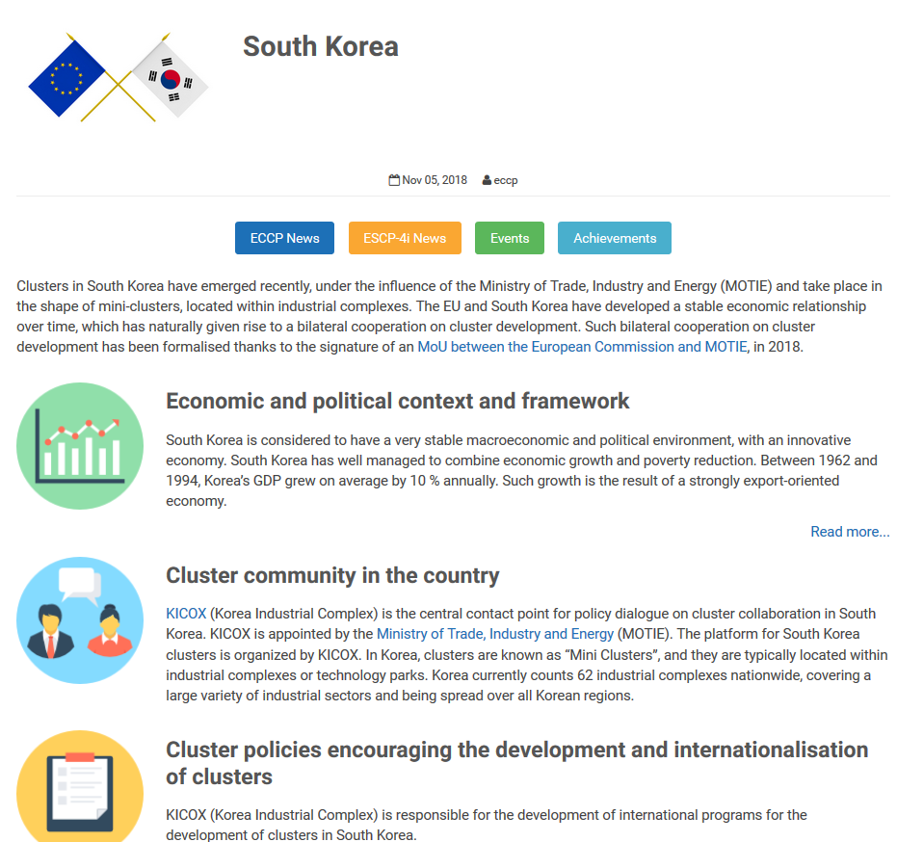
ECCP International Cooperation pages
Find out more on the cluster landscape instrategic third countries
Analysis reports illustrating strategic industry sectors, cluster mapping and cluster policy framework, as well as existing cluster-driven collaboration cases
Find out more about the existing EU support services and international initiatives

Slide 13
EU-Korea Cooperation cases (1/2)
Vitagora, French cluster in agrofood
Cooperation with the Korean Ministry of Agriculture, food and rural affaires
Cooperation established to support the creation of a Korean cluster on agrofood
Knowledge and good practices for the set-up of FoodPolis, the Korean cluster on food
Today, Vitagora and FoodPolis are cooperation partners, concretised with the signature of an MoU in 2013 and the organisation of several joint business missions

Slide 14
EU-Korea Cooperation cases (2/2)
3.4
ACCIO, the Catalan agency for regional development and competitiveness, supports 30 clusters present in the Catalonia region
Korea is a clear target market for Catalan companies for buisness and R&D collaboration
Business missions are organised on a regular basis by ACCIO and KICOX since 2015
Signature of an agreement in 2017 between the Government of Catalonia- through Accio- and the Korean National Research Council of Science and Technology (NST), an opportunity to deepen Catalonia-South Korea Cooperation
Signature of one cooperation agreement between a Catalan Cluster and a Korean on exchange of knowledge about market trends, exchange of company visits to establish potential collaboration between companies from both sides, joint R&D projects

Slide 15
EU-Korea good practices for cluster cooperation
To participate to international events and fairs to meet counterparts
To exchange knowledge and good practices as a starting point for cooperation
To have a local entry point to the Korean market (agency, company…)
To have good knowledge of the Korean language/culture and/or translators to facilitate exchanges
To open local offices in Korea to provide on-site support to both Korean and European organisations

Slide 16
ECCP on social media & news service
Follow us on Twitter! Clusters_EU
And on LinkedIn: https://www.linkedin.com/company/european-cluster-collaboration-platform-eccp/
And please remind your contacts to stay informed through our weekly digest and newsletter!

Slide 17
Thank you for your attention!
Support needed?
contact@clustercollaboration.eu
Feedback welcome
Marc Pattinson
ECCP Coordination Team

