Slide 1
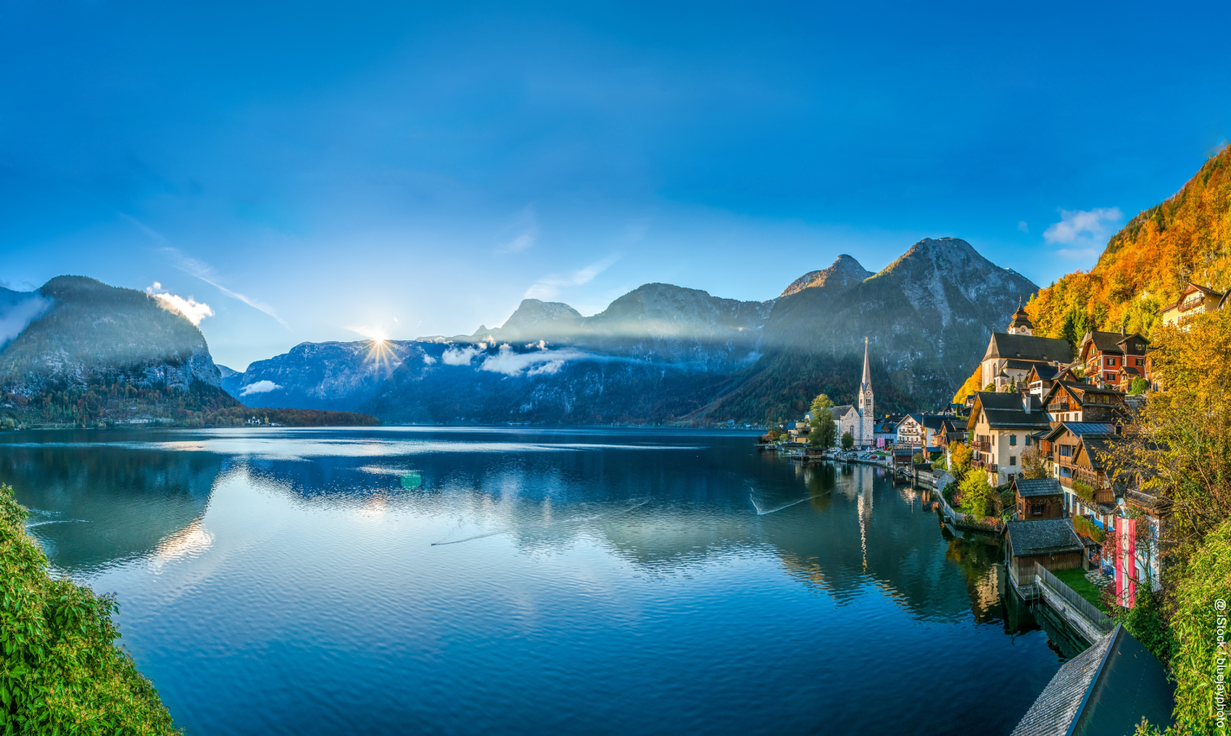
Sharing cluster SME experiences with the Korean market
@iStock / bluejayphoto
Eva Grafleitner / Christiane Egger
OÖ Energiesparverband/Cleantech-Cluster, Austria eva.grafleitner@esv.or.at, www.ctc-energy.at

Slide 2
South Korea AUSTRIA
51.7 million Population 8.8 million
99,000 km² Surface area 83,879 km²
1.7 trillion USD GDP 0.4 trillion USD
Sources: statista.com

Slide 3
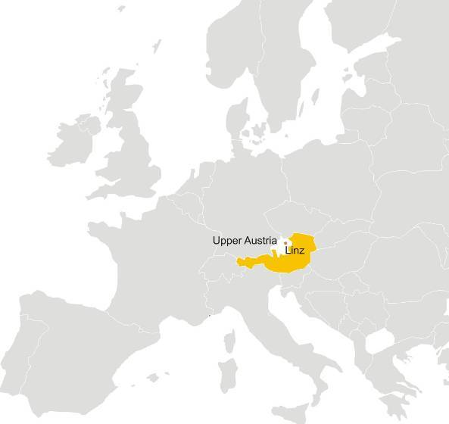
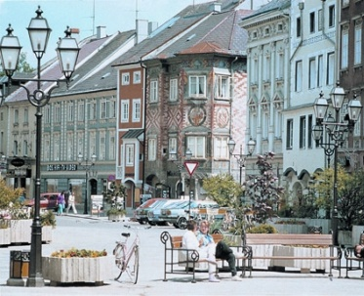
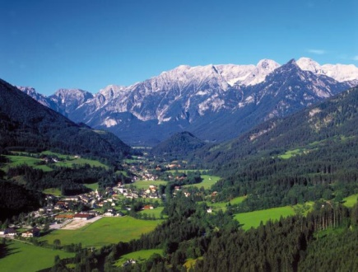
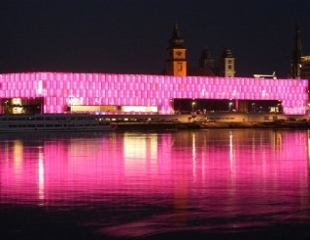
The region of Upper Austria
Capital: Linz
Population: 1.45 million Area: 12,000 km²
Economic activity: 25% of the Austrian industrial exports

Slide 4
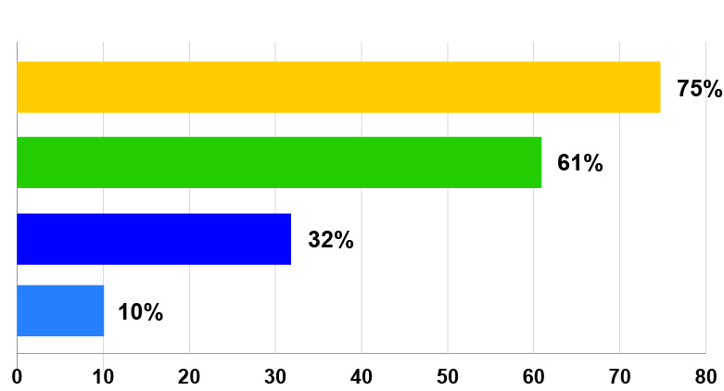
Share of renewable energy in different sectors
Upper Austria
Electricity
Space heating
Primary energy consumption
Mobility

Slide 5
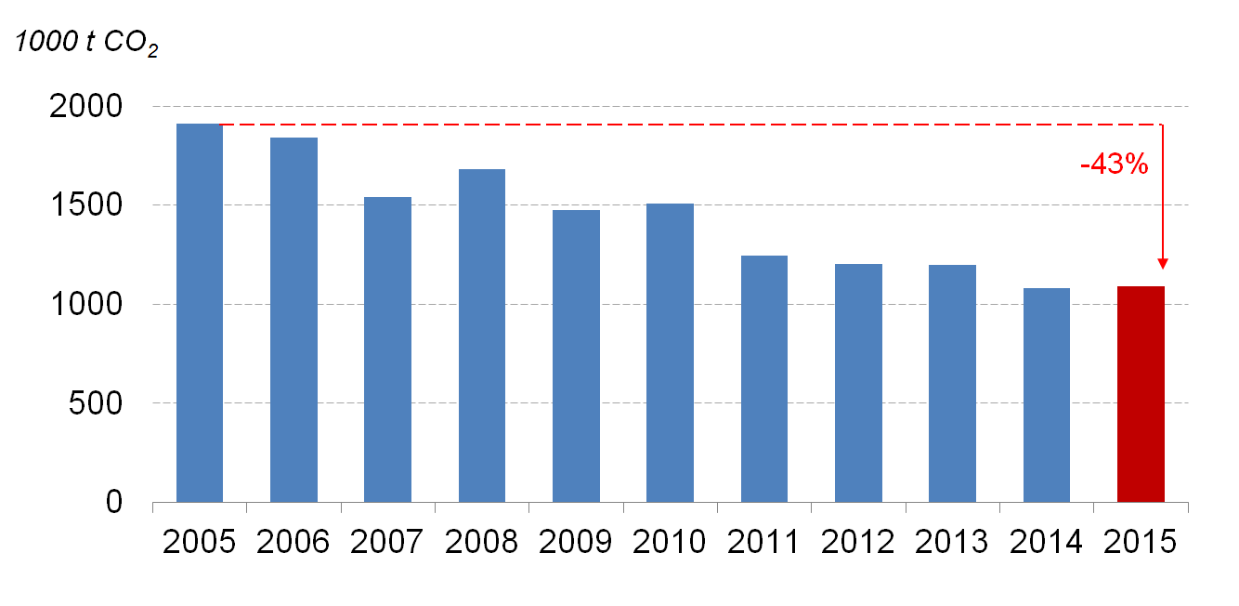
Greenhouse gas emissions from buildings
Upper Austria
-43%
Source: UBA

Slide 6
Sustainable energy investments in Upper Austria: > 2 billion Euro annually
Investments in energy efficiency: 1.5 billion Euro/year
Investments in renewable energy: 0.6 billion Euro/year

Slide 7
The vision: European leader in the energy transition
competitiveness and quality of life through decarbonision (and not: despite of)
decarbonisation energy used for buildings and manufacturing
market leadership in innovative energy and building products
innovation ecosystem

Slide 8
Cleantech Cluster
Changing energy & environment
the Cleantech-Cluster bundles the activities of two networks, the Okoenergie-Cluster and Environmental Technology Cluster
a business network with 250+ companies
two specialised teams: - energy technologies (OÖ Energiesparverband) - environmental technologies (Business Upper Austria)
technologies covered by the CTC: - energy technologies (energy production, storage, distribution, energy efficiency and renewable energy sources) - environmental technologies (water, air, waste, recycling, resource efficiency in manufacturing)

Slide 9
small hydro & wind
heat pumps/ geothermal
solar + storage
biomass
energy consul-tants/building certificates
energy manage-ment/building Technologies
architects/ construction businesses
building
materials
training & research
contractors / plant operators
suppliers/ wholesalers/ other
lighting

Slide 10
Value chain: building and energy technologies
Research
Product development
ManufacturingBuilding Technologies
Planning & constructing & installing
Sales
Operation, maintenance
Universities,
Research organisations
Manu- facturers
Manufacturers
Component suppliers
Manufacturers
Distributors (often multi- level)
Building owners
Planners & installers (architects, construction companies, HVAC, energy companies etc.)
Banks, developers, real estate sector
ESCOs
Building owners
Facility and property managers
ESCOs, installers
Actor groups
Innovation across the value chain
Manufacturers building materials (e.g. bricks, insulation materials, sun protection...)
Manufacturer energy technologies (zB. biomass, solar, heat pumps, cooling, lighting, energy management systems...)
Component suppliers
Universities and research organisations
Manu-facturers
Wholesale
Installers
Architects, builders, developers, HVAC and electric planners, energy advisers ESCOs Buildings owners Schools
Building owners
Facility and property managers
ESCOs, installers
Our network

Slide 11
General CTC activities
Keeping markets developments on our "radar" Market screening, on-going discussion with cluster partners on interesting developments, European projects
Partnerships with energy organisations around the globe
Presentations at international conferences, hosting of delegations & experts
Own events and publications International newsletter, partner and products guides, international conference World Sustainable Energy Days, international training seminars
Market exploration tours and tradeshow stands: before 2008 Europe (e.g. France/Spain/UK/Finland), after 2008: several US trips, Chile
Digitalisation trip to the US in 2017

Slide 12
Cluster Support to SMEs for
internationalisation
SMEs face the following challenges:
globalisation affects more and more markets
they often lack of resources and skills
difficulty in accessing knowledge on most promising markets for their products
Cluster are both specialists in the sector and in internationalisation, they support SMEs for example with:
screening markets worldwide
training for cluster companies
organisation of market exploration tours, stands at trade shows
help with finding specific business partners and adaption products to new markets
etc.

Slide 13
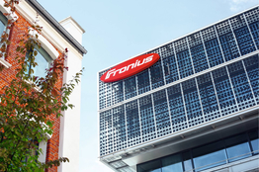
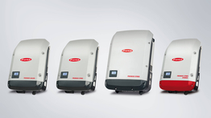
Fronius - Solar solutions that last
Family-owned business since 1945
Specialist in solar energy, welding and charging
production and sales of inverters
energy storage and energy management solutions
planning and monitoring of photovoltaic projects
PV-Genset, MicroGrid solution
Export rate: 93%
Staff: 4,550
Presence in South Korea (welding division) http://www.bestfa.co.kr/about-us/
Website: http://www.fronius.com/en

Slide 14
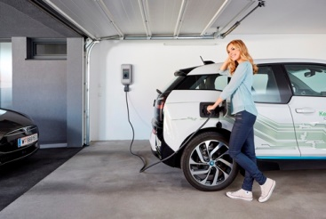
KEBA - Automation by innovation
1,040 employees, export rate of 87 % , three business divisions:
industrial automation
banking and service automation
energy automation
charging infrastructure for electric mobility
Keba wall boxes available in 45 countries
over 34,000 intelligent charging stations sold in 2017 (80,000 in total)
KEBA Korea Ltd.: 205, 235, Pangyoyeok-Ro, Bundang-Gu, Seongnam-Si,Gyeonggi-Do, Korea (Postal code: 13494)
+82 31 603 2200; korea@keba.com; https://www.keba.com/en/home

Slide 15
Lession learnt: How to make international cooperation a success
first step: learn a lot about each other
have a bigger aspiration that simply exchanging goods and services - build partnerships (give-and- take)!
it takes longer than you think
both economies can greatly profit!
Notes:
15

Slide 16
We put our energy into internationalisation!
@iStock / bluejayphoto
Eva Grafleitner / Christiane Egger
OÖ Energiesparverband/Cleantech-Cluster, Austria eva.grafleitner@esv.or.at, www.ctc-energy.at

