Slide 1
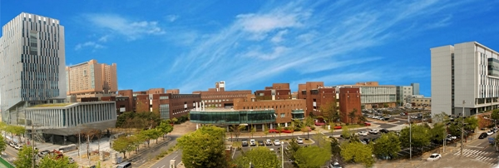
EU–Korea Cluster Matchmaking Event 2018 thankyou
Korea Polytechnic University

Slide 2
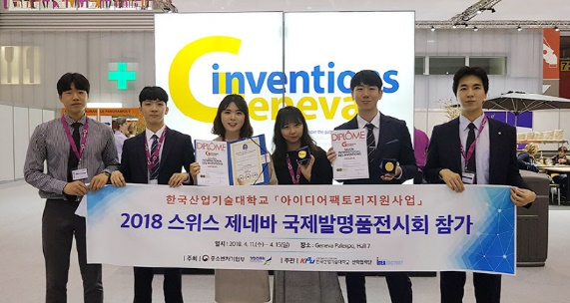
EU–Korea Cluster Matchmaking Event 2018 thankyou
KPU is contributing to the industrial development of the nation
by training future workers in the field of science, engineering and design.

Slide 3
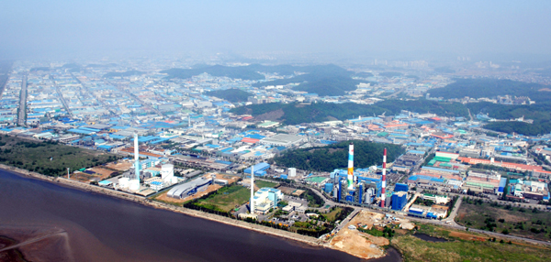
EU–Korea Cluster Matchmaking Event 2018 thankyou
Siheung-Ansan Smart Hub : Korea’s largest national complex home to 19,000 components companies

Slide 4
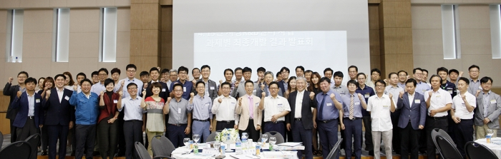
EU–Korea Cluster Matchmaking Event 2018 thankyou
KPU created a “Family (Partner) Company” system playing a role as a leading institution in industry-university cooperation

Slide 5
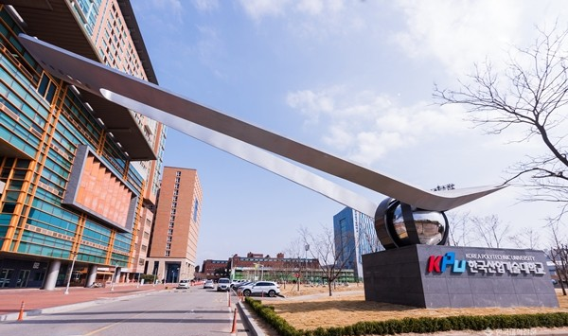
EU–Korea Cluster Matchmaking Event 2018 thankyou
Industry-Academic Cooperation Foundation
The powerful wings of KPU represent our mission to become a prestigious global industry-academy

Slide 6
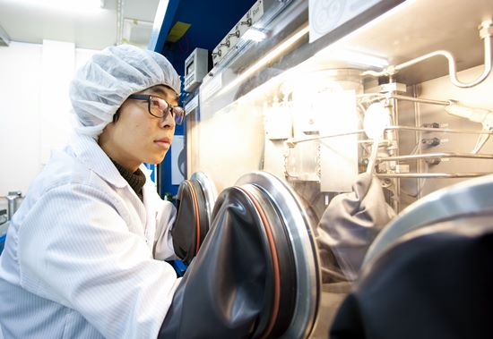
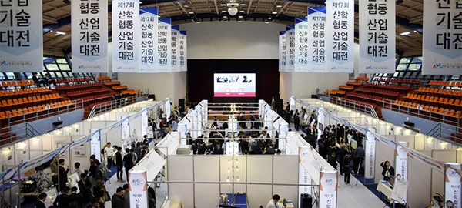
EU–Korea Cluster Matchmaking Event 2018 thankyou
A Leader of Creation & Innovation

Slide 7
EU–Korea Cluster Matchmaking Event 2018 thankyou
Industry-Academic Research Support Headquarters
Research Business Group
Technology Commercialization Support Headquarters
Industry-Academic
Cooperation Foundation
Start-up Support Headquarters
Industry-Academic Link Support Headquarters
The Industry-Academic Cooperation Foundation consists of five major organizations

Slide 8
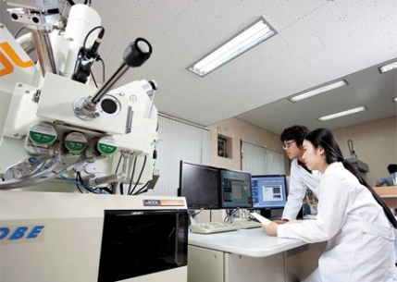
EU–Korea Cluster Matchmaking Event 2018 thankyou
Industry-Academic Link Support Headquarters
Field Education Support Center / Public Equipment Support Center / Family Company Support Center

Slide 9
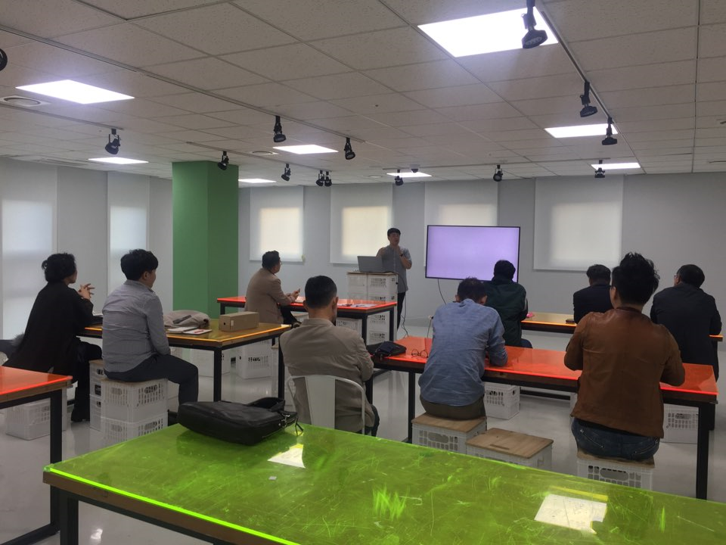
EU–Korea Cluster Matchmaking Event 2018 thankyou
clusters (Industry-Academia Cooperation Council )of KPU 2018
Manufacturing Innovation Chief Management and Techno Management cluster
Smart Manufacturing Competitiveness cluster
Machinery Design cluster
Precision Motion System cluster
Technology Transfer Projects cluster
Convergence Knowledge cluster
Smart Factoring cluster
Artificial Intelligence cluster
Micro-electronics manufacturing industry cluster
Part material and new technology exchange cluster
Upcycling design cluster
Smart Environment / Technology cluster
Photon Convergence Field Practice Mentor Exchange Meeting cluster
Photovoltaic Device and Applied cluster
Export-Academic Cooperation Council
DEI cluster
Technology and information sharing between faculty and companies, network building, organization of cooperative bodies to perform joint research assignments, support for paid family company system operation

Slide 10
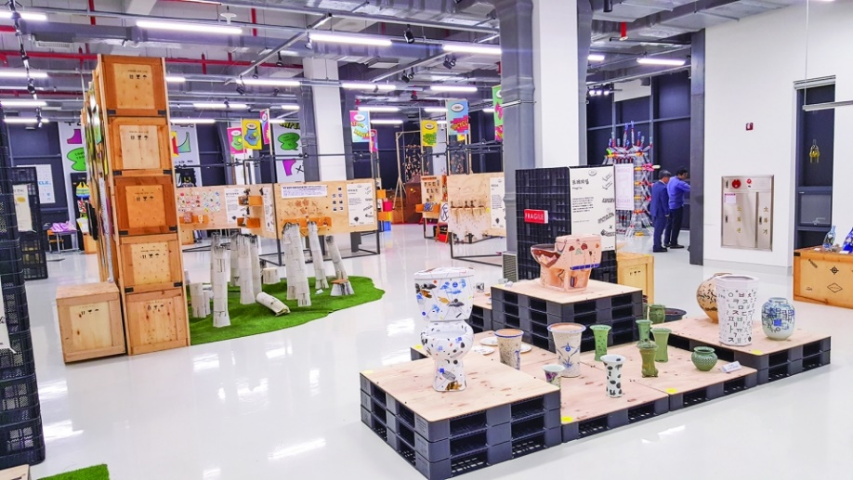
EU–Korea Cluster Matchmaking Event 2018 thankyou
Upcycling Design Cluster
Eco-friendly issues have emerged across society and industry
Activation of recycling industry to reduce waste as part of eco-friendly project
To promote green industry by giving design value to recycling concept
Growth prospects of domestic and overseas environment industry market
Propose a new method of resource circulation through design value

Slide 11
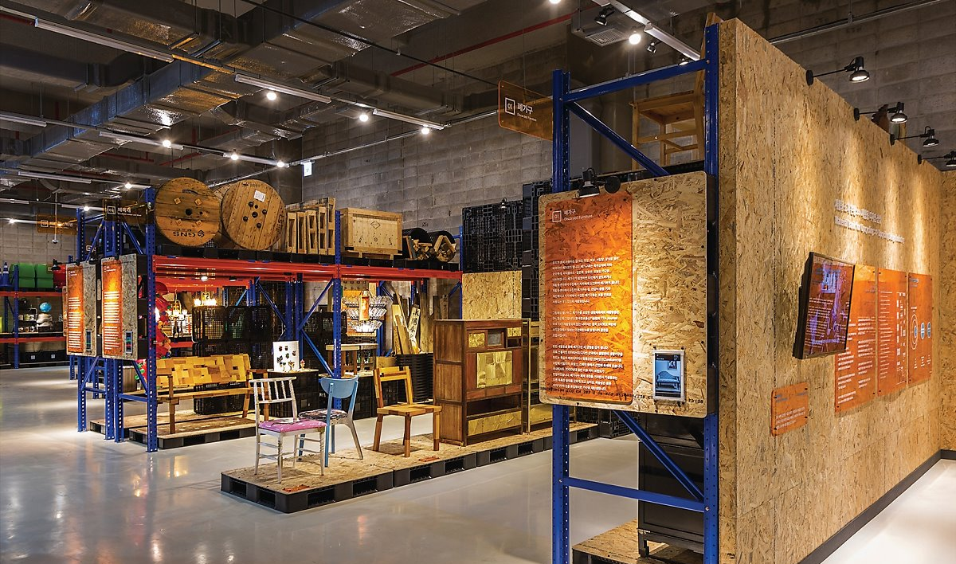
EU–Korea Cluster Matchmaking Event 2018 thankyou
Upcycling involves a resource circulation that can protect the environment and practice resource circulation.

Slide 12
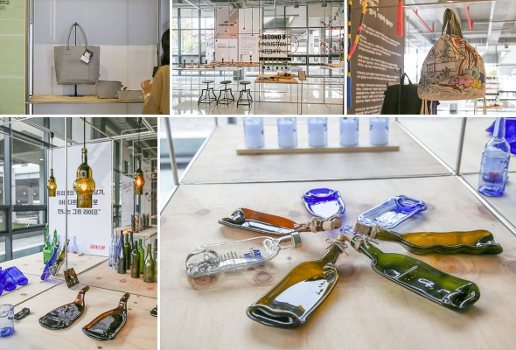
EU–Korea Cluster Matchmaking Event 2018 thankyou
It is oriented towards sustainable growth of companies related to material recycling and reuse

Slide 13
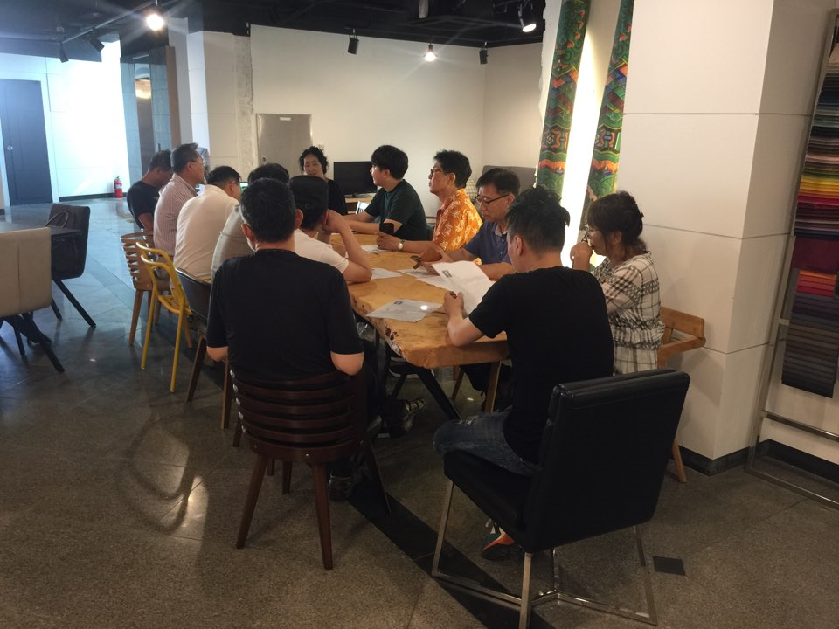
EU–Korea Cluster Matchmaking Event 2018 thankyou
The Upcycling Design Cluster is made up of 12 companies and each has a different business
Design Development / Material / Arts & Inspiration / Products / Sales & marketing

Slide 14
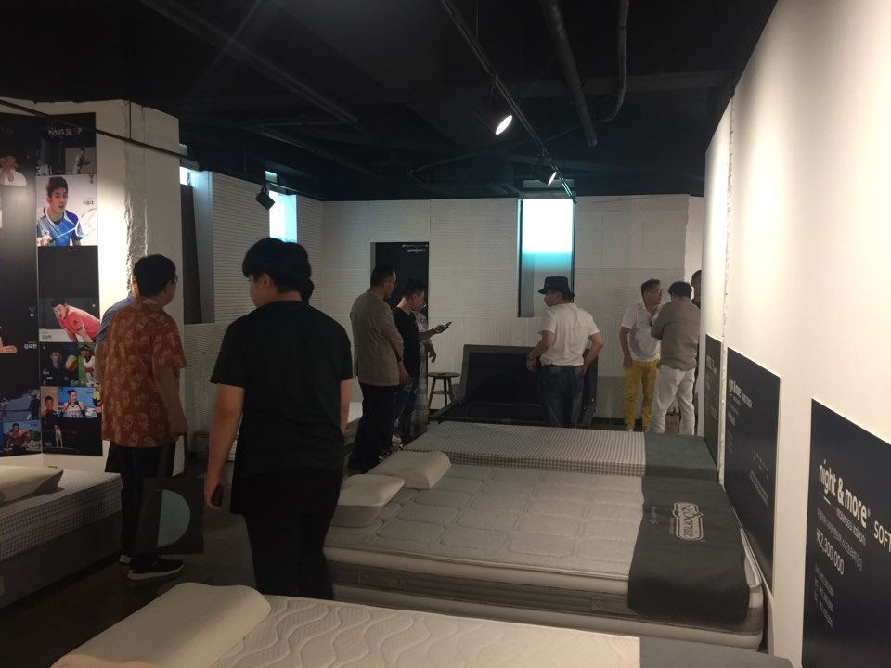
EU–Korea Cluster Matchmaking Event 2018 thankyou
Key Activities of Cluster
To Find and Setup New upcycling design business
- Understanding upcycling concept of design industry
Design: Study on properties and processing methods of various materials
Manufacturing: Mass production through rework of specific materials
Marketing: Seeking ways to find and expand markets
Sharing information of Industry trends, market and drawing up diverse ideas
through discussion on common issues
- Holding seminars by inviting experts from various industries
Complement each other's needs of tech and materials through close exchanges
between companies ( company tour, Occasional meeting individually,
- Continue to find new partners with common interest.
Complement each other's needs of tech and materials through close exchanges between companies

Slide 15
EU–Korea Cluster Matchmaking Event 2018 thankyou
Thank you
To create mutual business opportunities through a close network in the future

