Slide 1
EU GATEWAY TO KOREA
Facilitating long-lasting business collaborations
Between Korea and the EU
Catherine FRIDERES, Coaching Network

Slide 2
Business opportunities at high value and low risk.

Slide 3
Why go international?
Benefits of business
collaboration
Exit
Accelerate revenue growth
Market diversification
Get economies of scale
Diversify risk
Beat competition
Get pricing leadership
Attract A+ talent
Optimise cost structure
Less dependent on local economy
Shareholder value creation
Global value acceleration
Global
Local/ regional market proven
Technology proven
Time
Create shareholder
value !

Slide 4
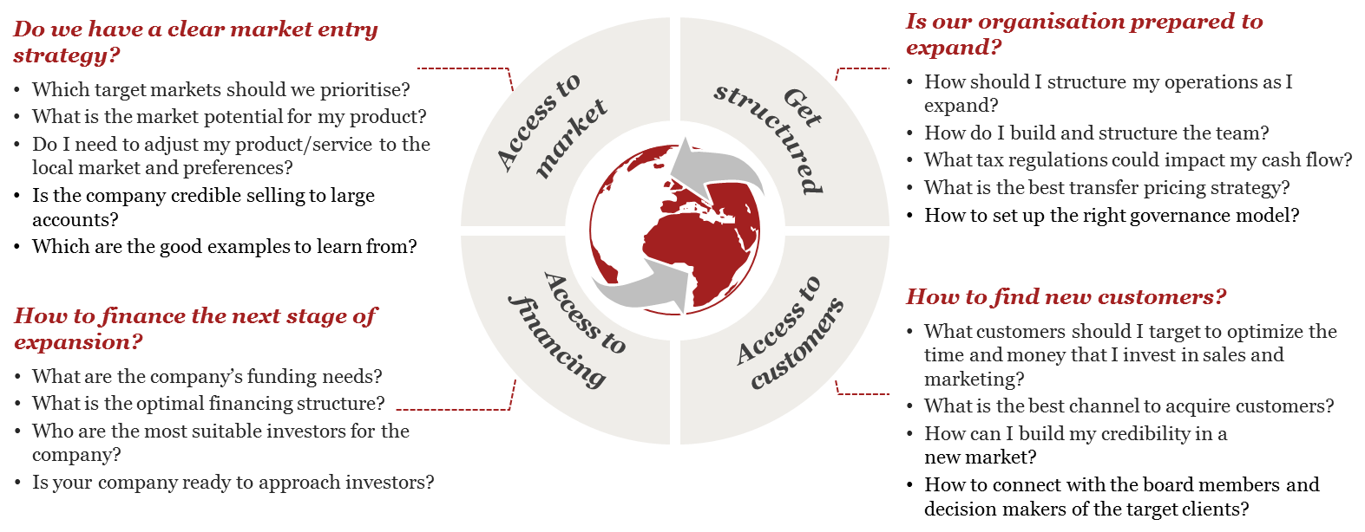
Companies that expand must answer critical questions

Slide 5
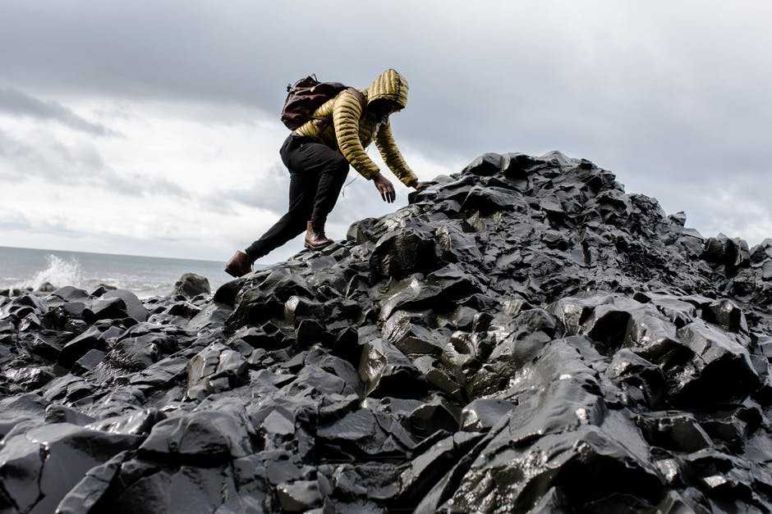
And face several barriers.
Internal barriers
External barriers
Price of their product or service (depends on general prices in the home market and the level of business efficiency)
Product quality and specifications
High cost of internationalisation
Language barriers
Lack of managerial time
Not enough and/or untrained staff
Lack of knowledge and necessary skills on external markets, international business, marketing and management skills
Lack of capital to finance international activities
Lack of adequate public support (fragmentation and overlap of the existing support measures as well as the lack of coordination between the responsible government bodies)
Lack of adequate information on potential overseas business partner and customers
Laws and regulations in the foreign country (contract law, customs rules, technical regulations and standards, technology transfer, intellectual or industrial property rights)
Tariffs or other trade barriers in the foreign market
Cultural differences
Potentially uncertain political fundamentals
Overwhelming bureaucratic policies (e.g. paperwork needed for transport)
Difficulty of obtaining reliable foreign representation
Exchange rate fluctuations

Slide 6
A structured approach for facilitating long-lasting business collaborations.

Slide 7
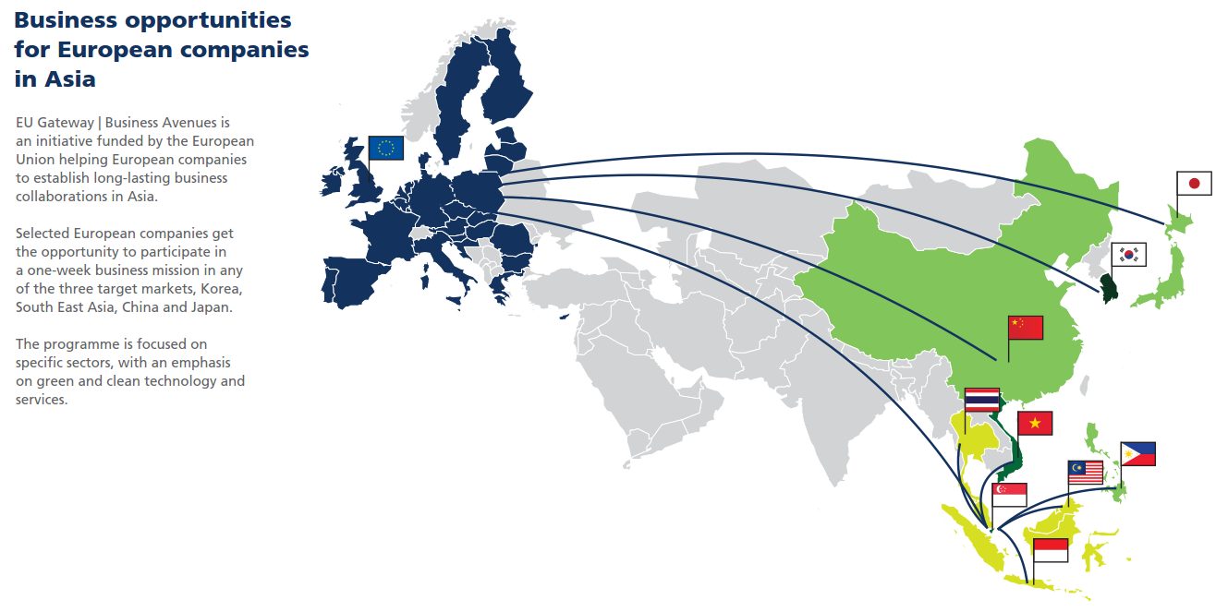
Over 50 Business Missions from 2016 to 2020. Open to 2700 European companies and targeting 9 Sectors
four

Slide 8
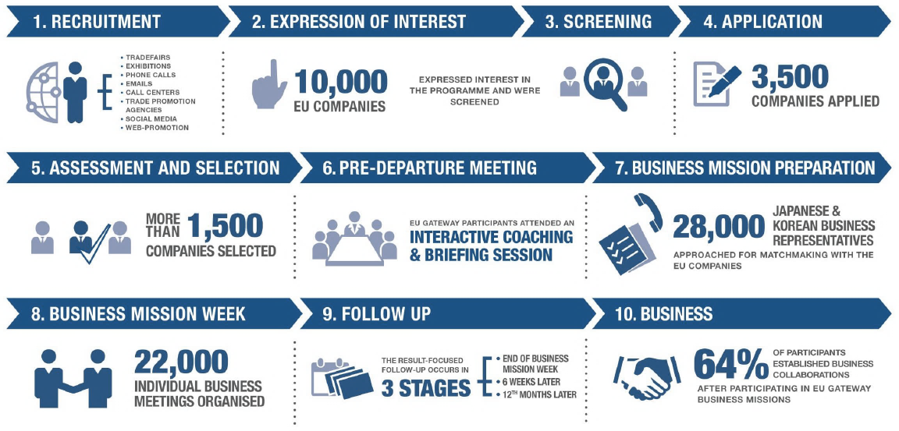
The mission life cycle

Slide 9
Benefits for companies
Privileged access to focused business opportunities
Meetings with select business partners
Readily available market intelligence
Participation in large sector events
Low entry costs
Tailored coaching on internationalisation strategy
Services on the spot
Post-mission business support to facilitate the deal

Slide 10
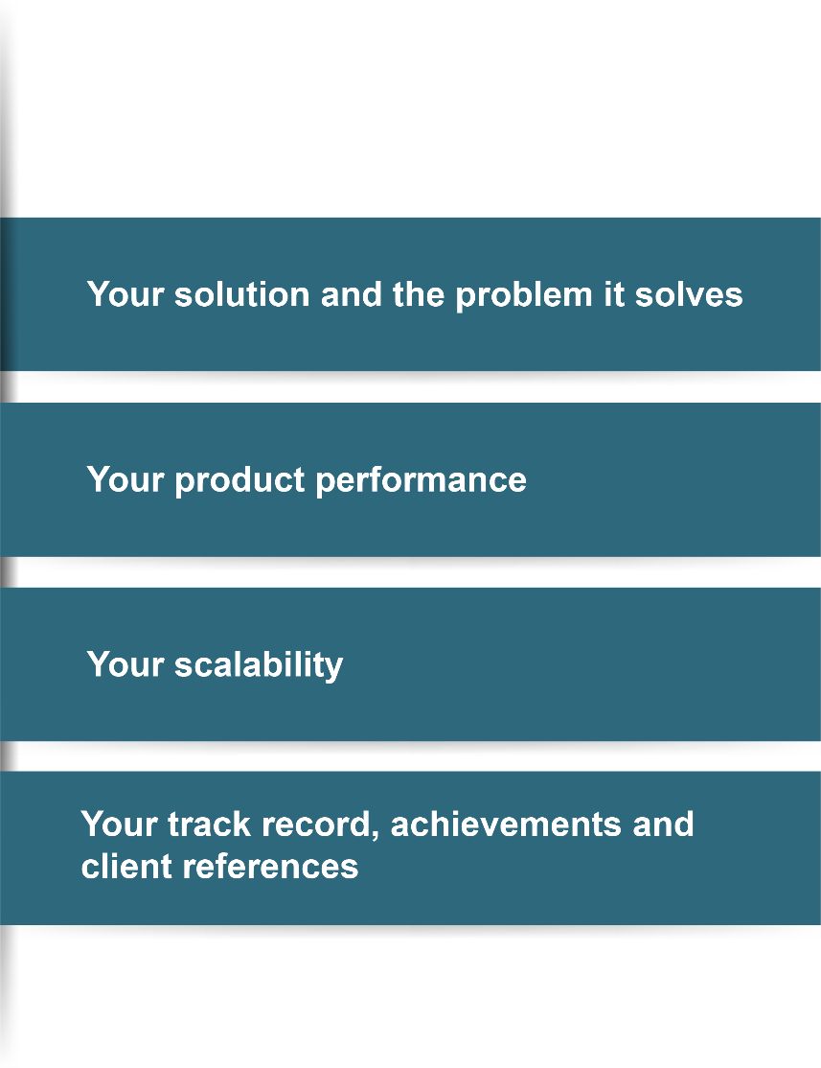
Market-driven approach
Eligibility criteria
A solution that is relevant for the market
Minimum 3 years’ existence (3 years of financial figures)
Headquarters in the EU and majority-owned by EU shareholders
The size, expertise and strategy to enter Asia
A proven track record of international business cooperation
Engaged in technology, manufacturing or engineering activities
Value proposition

Slide 13
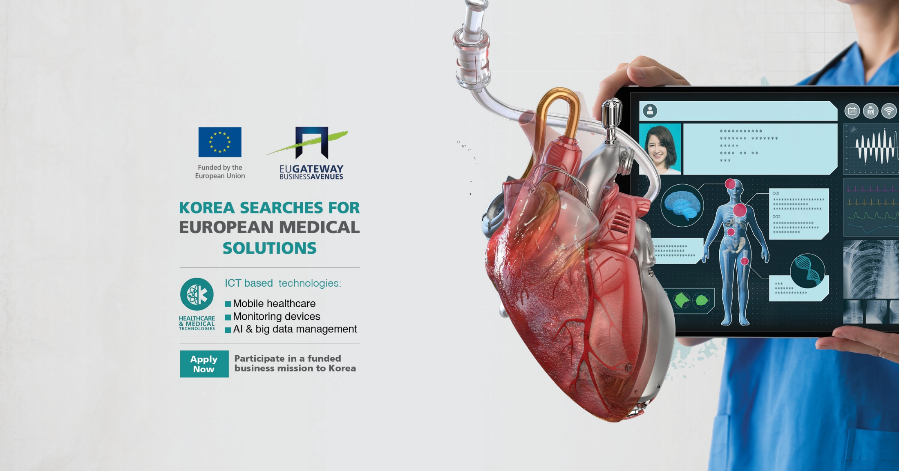

Slide 14
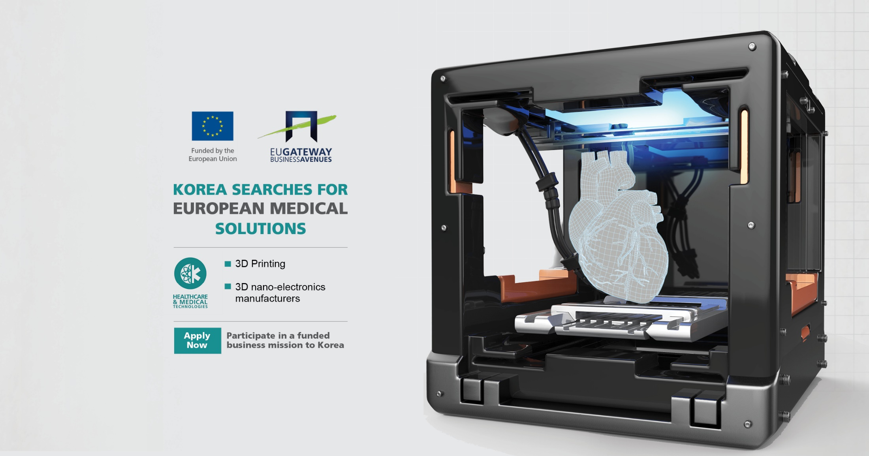

Slide 15
EU Gateway to Korea: Key figures
9 Business Missions
37,604 companies contacted
20,528 companies interested
1,734 eligible Expressions of Interest
949 applications
539 selected
6,811 meetings conducted
3,921 pre-arranged
4,587 useful
5 sectors
Green Energy Technologies Environment & Water Tech
Healthcare & Medical Tech
Organic Food & Beverage
Contemporary European Design
96% satisfied
97% will apply again

Slide 16
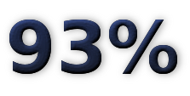
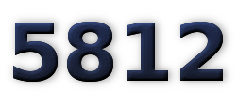
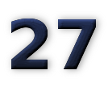
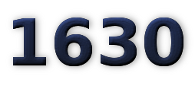
Track record
Achievements up to 2018
Proven methodology from the identification of targets and opportunities to the final follow-up, feedback mechanisms and impact assessment.
OVERALL SATISFACTION RATE
MATCHMAKING AND MEETINGS ORGANISED DURING THE MISSIONS GENERATING
HUNDREDS OF LEADS AND CONTRACTS
EXPRESSIONS OF INTEREST TO PARTICIPATE
TO A BUSINESS MISSION
BUSINESS
MISSIONS DONE
PARTICIPANTS COACHED AND SELECTED TO GO ON A BUSINESS MISSION IN
CHINA, JAPAN, KOREA AND SOUTH EAST ASIA

Slide 17
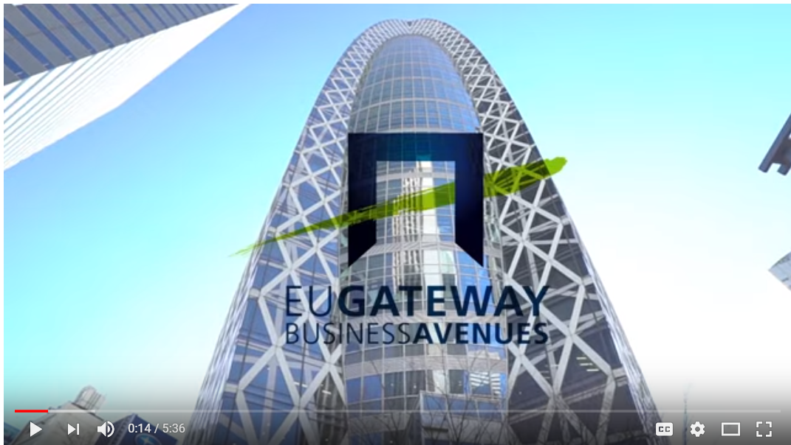
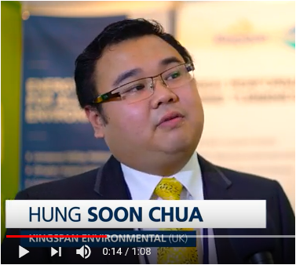
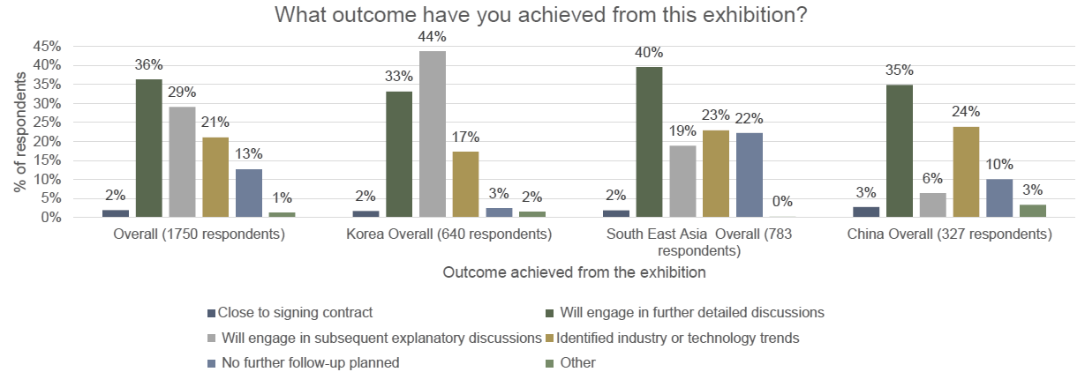
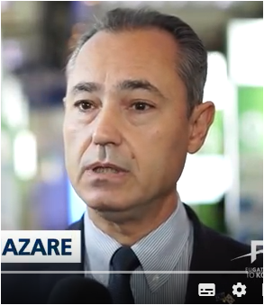
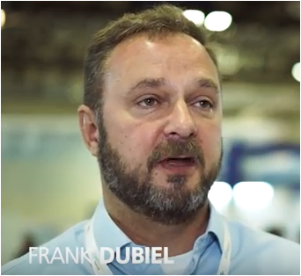
Participant feedback
Results in numbers
Results through participants’ testimonies
94% of companies believe the participation was very useful in getting a better understanding of the target market
89% expect their business to grow in the target markets
56% concludes/expect sales or signed contract from their participation
52% increase the number of people employed since their participation
More than 150 video testimonials
“ I established a partnership with a Malaysian Company, they are now acting as our local representative”
- Kingspan Environmental
“Many quality meetings”
- Aqylon
“You get all the help and the service so you can concentrate on customers”
- Kunste Instruments

Slide 18
THANK YOU!
catherine.frideres@eu-gateway.eu

